Slide 1


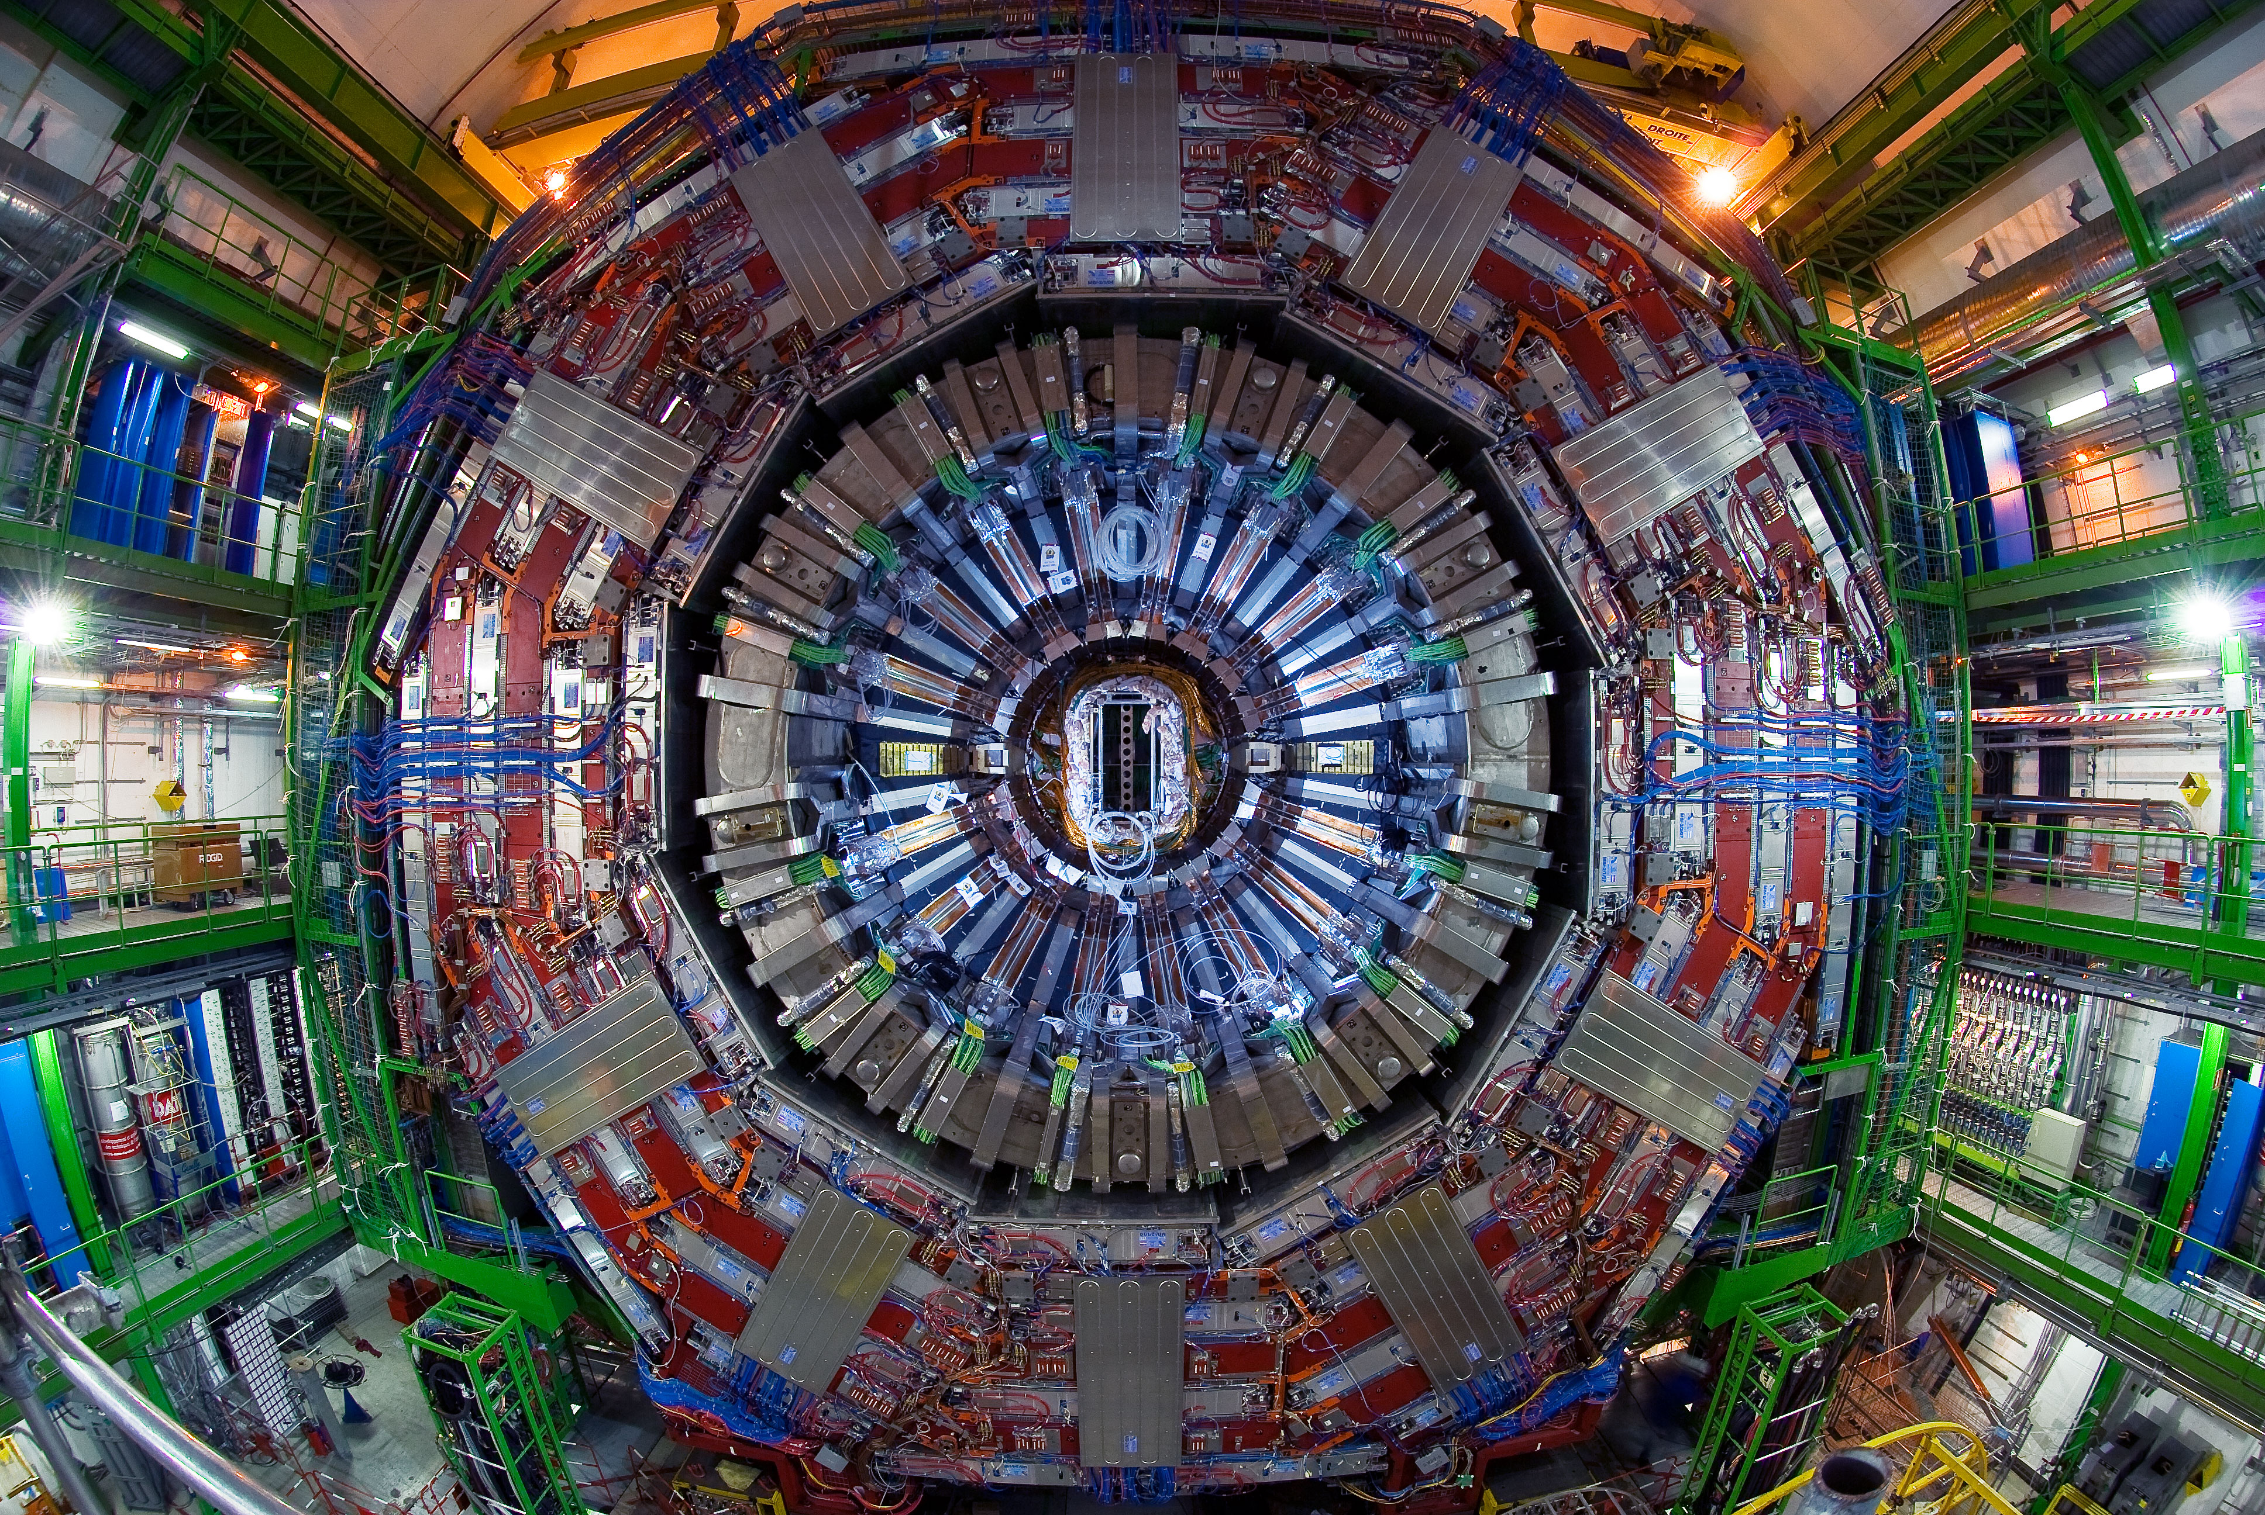


Physics at the LHC
Claudio Campagnari
April 6, 2016

Slide 2
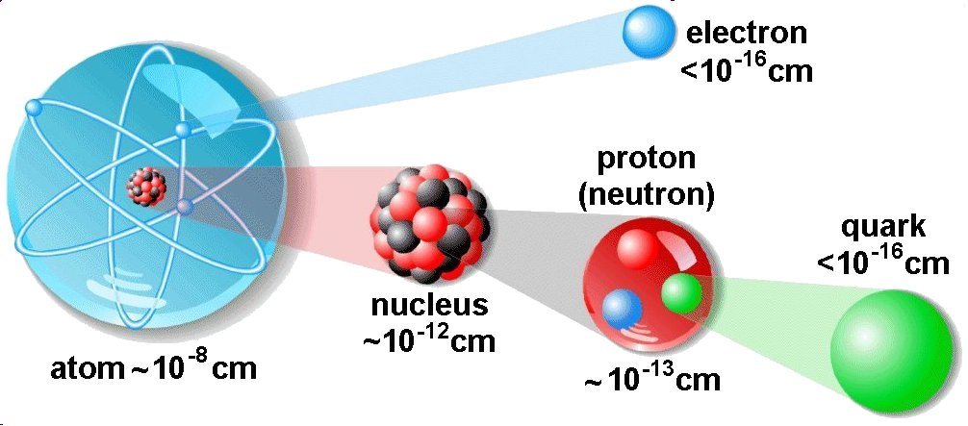
Particle Physics
The study of the fundamental building blocks of matter and their interactions

Slide 3
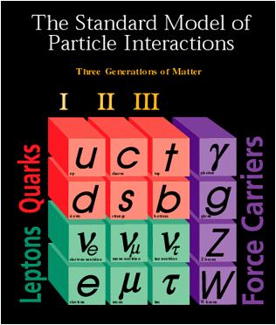
“Standard Model” is a theory of
elementary particles developed in
the 60’s and 70’s.
It works extremely well in describing
the interactions of particles observed
in experiments.
But there are several open questions.
The theory is incomplete.
The periodic table of particle physicists

Slide 4
The questions of particle physics
Matter/antimatter asymmetry in the universe?
Dark matter? Dark energy?
Why 3 generations?
Why are the masses what they are and why are they so different?
How do quarks and leptons and W/Z bosons get their mass? (The Higgs and all that)
Are quarks and leptons really fundamental?
What about gravity?

Slide 5
The questions of particle physics
Matter/antimatter asymmetry in the universe?
Dark matter? Dark energy?
Why 3 generations?
Why are the masses what they are and why are they so different?
How do quarks and leptons and W/Z bosons get their mass? (The Higgs and all that)
Are quarks and leptons really fundamental?
What about gravity?
The LHC was built to make experimental
progress on many of these questions
by studying interactions at ~ TeV energy scale

Slide 6
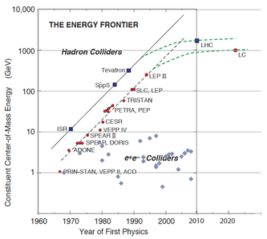
The LHC
A proton-proton collider with 13 TeV in the center of mass
In a 17 mile long circular tunnel on the Swiss-French border near Geneva, 300 ft below ground

Slide 7
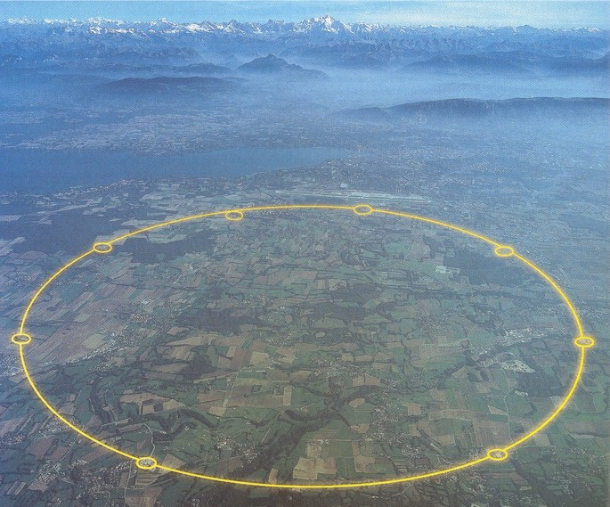
Mont Blanc
Downtown
Geneva
Airport
CERN
“campus”
Switzerland
France
ATLAS
Detector
CMS
Detector
A 17 mile long tunnel 300 ft below ground

Slide 8
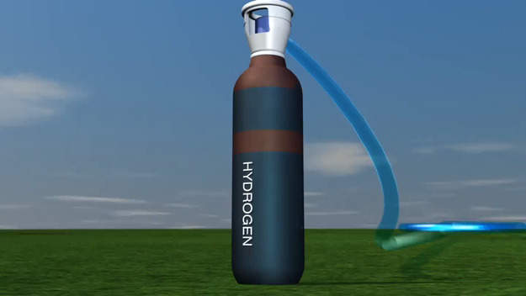

Slide 9
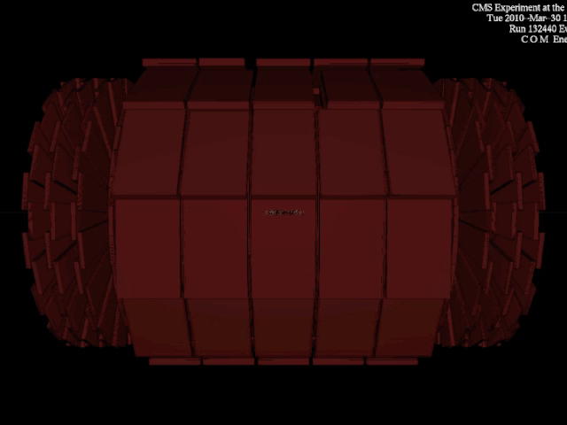

Slide 10
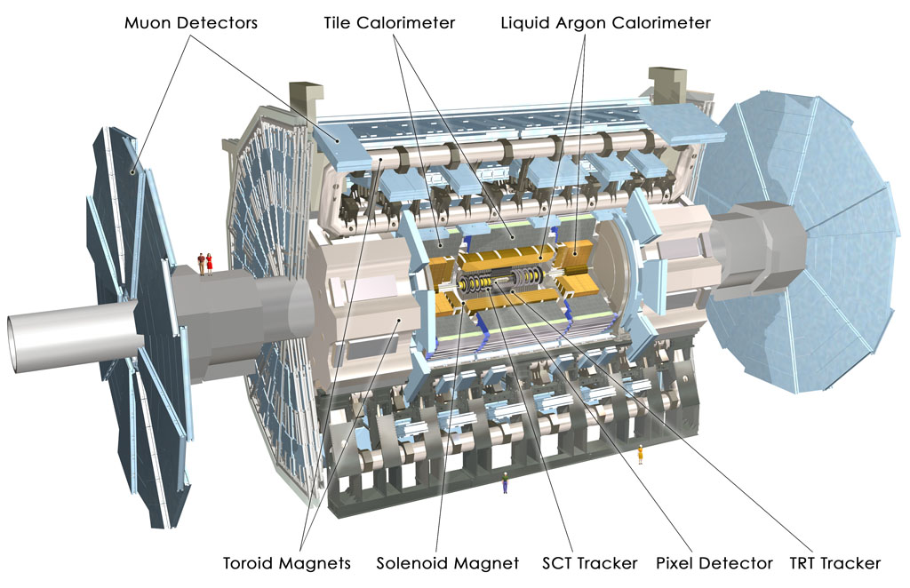

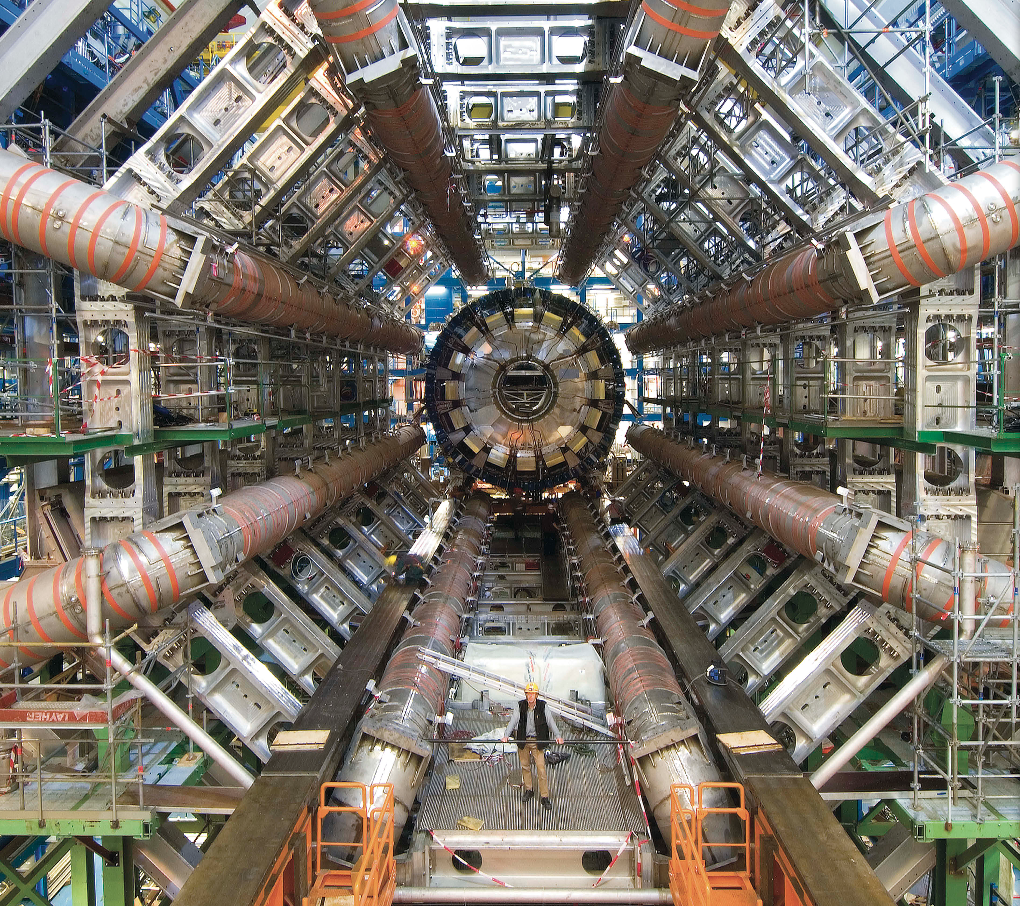

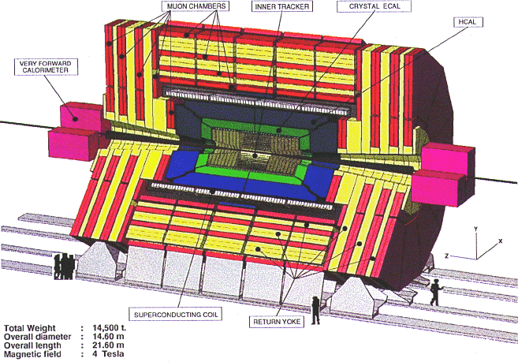
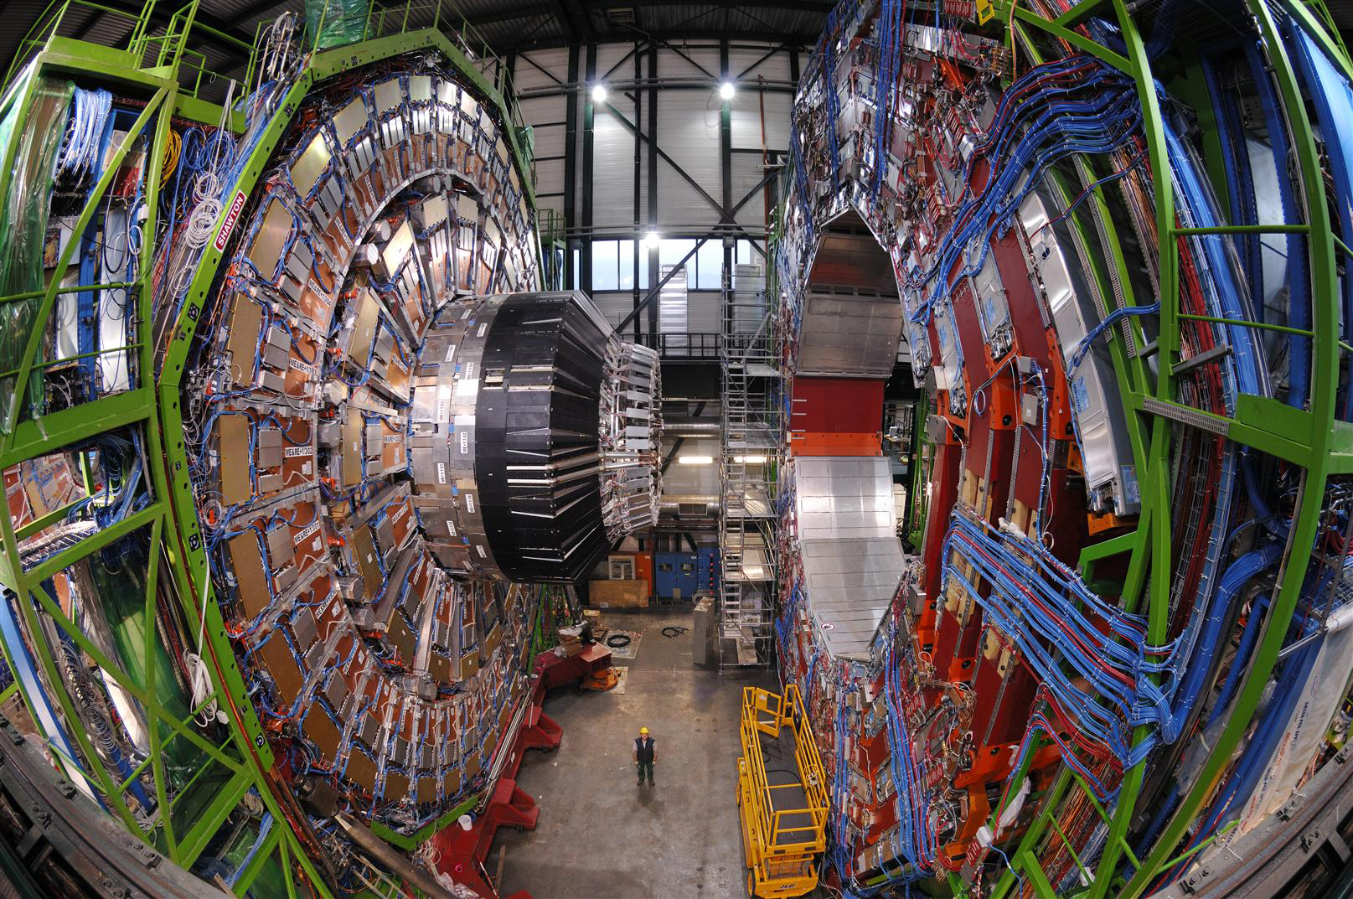

Slide 11
More fun facts about the LHC
1232 superconducting dipole magnets to bend the beams
  15 m long. T=1.9K. B=8.4 T. I=11,700 A
Also 392 superconducting quadrupoles to keep the beams focused.
96 tonnes of liquid He
17 miles long vacuum pipe
Protons go around the ring 11,000 times a second
“Bunches” of protons collide every 25 nsec
Each bunch has a transverse size of about 50 μm and is ~ 2 cm long
There are about 10¹¹ protons in each bunch
Most protons just fly through.
Only about 20 per bunch hit a proton from the other bunch and interact

Slide 12
How do we distinguish different particles in the collision

Slide 13
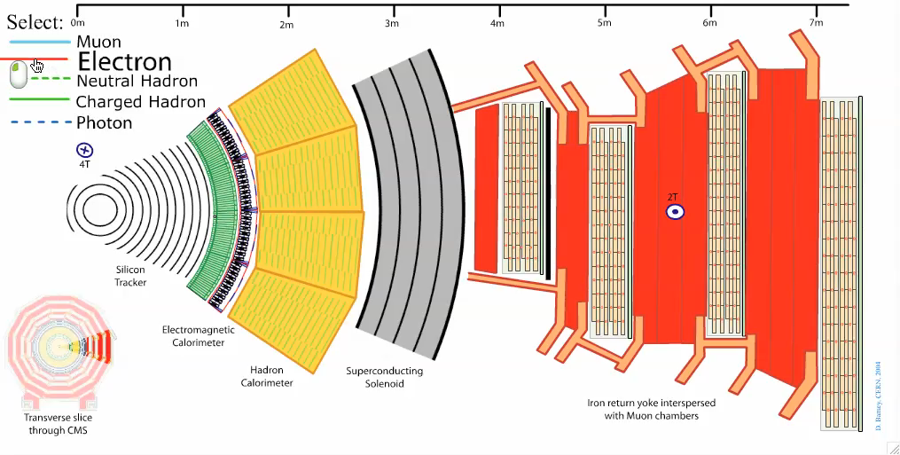
Electrons

Slide 14
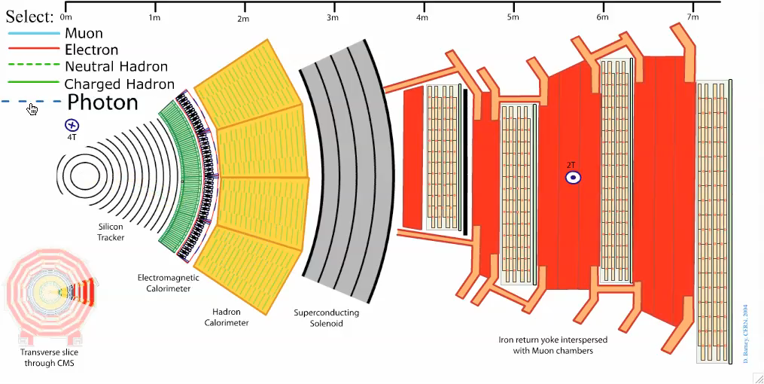
Photons

Slide 15
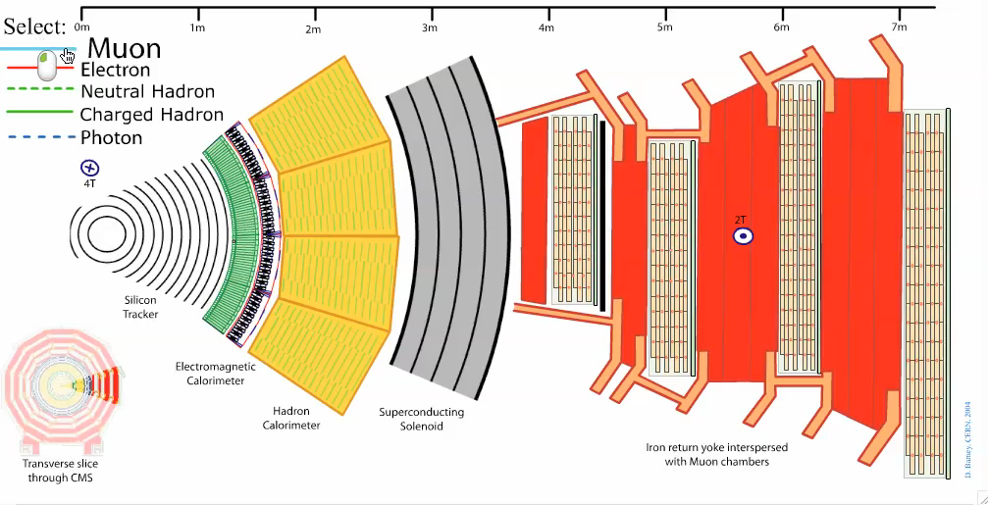
Muons

Slide 16

Charged Hadrons (e.g., protons)

Slide 17
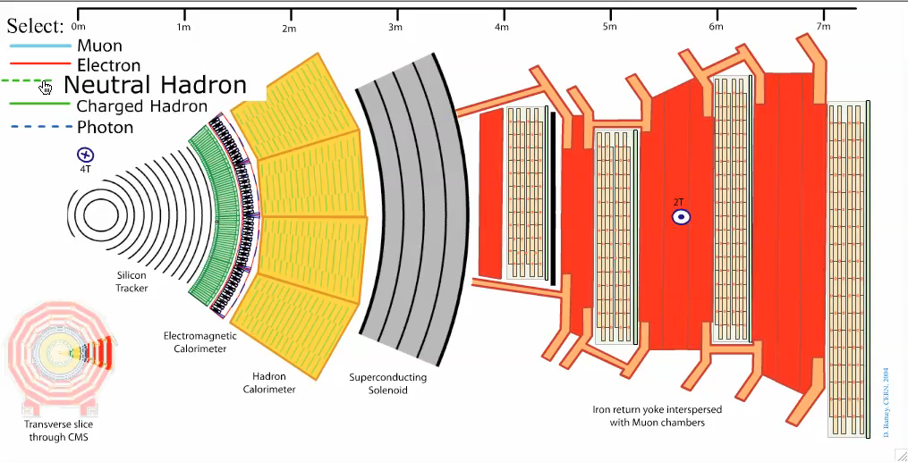
Neutral Hadrons (e.g., neutrons)

Slide 18
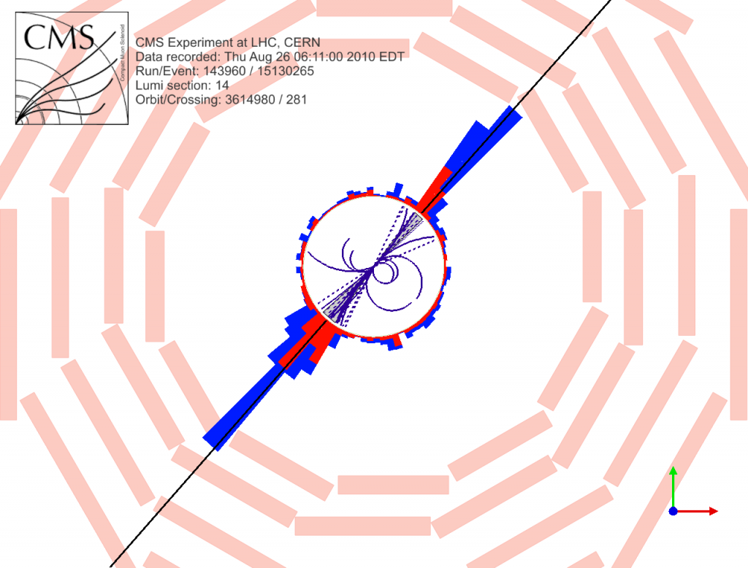
Quarks and gluons: "jets"

Slide 19
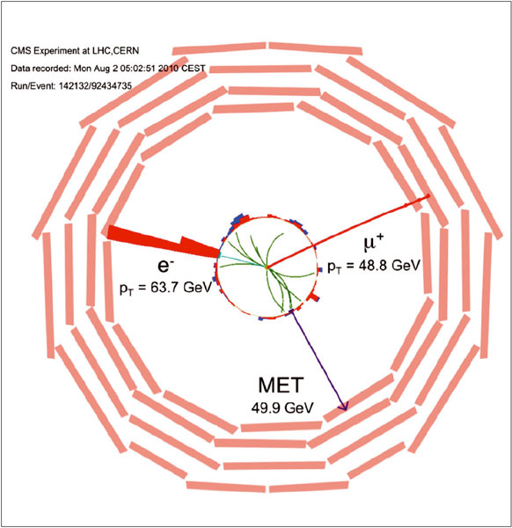
Neutrinos, dark matter...
pp → W⁺ W⁻
W⁻ → e⁻ ν
W⁺ → μ⁺ ν

Slide 20
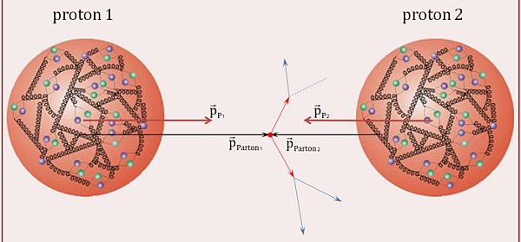



Proton-Proton interactions
Protons are "composite" particles
We care mostly about the collisions of constituents
  quarks, gluons: aka partons

Slide 21
Like "broadband" beams
Collisions at the highest energies are rare

Slide 22
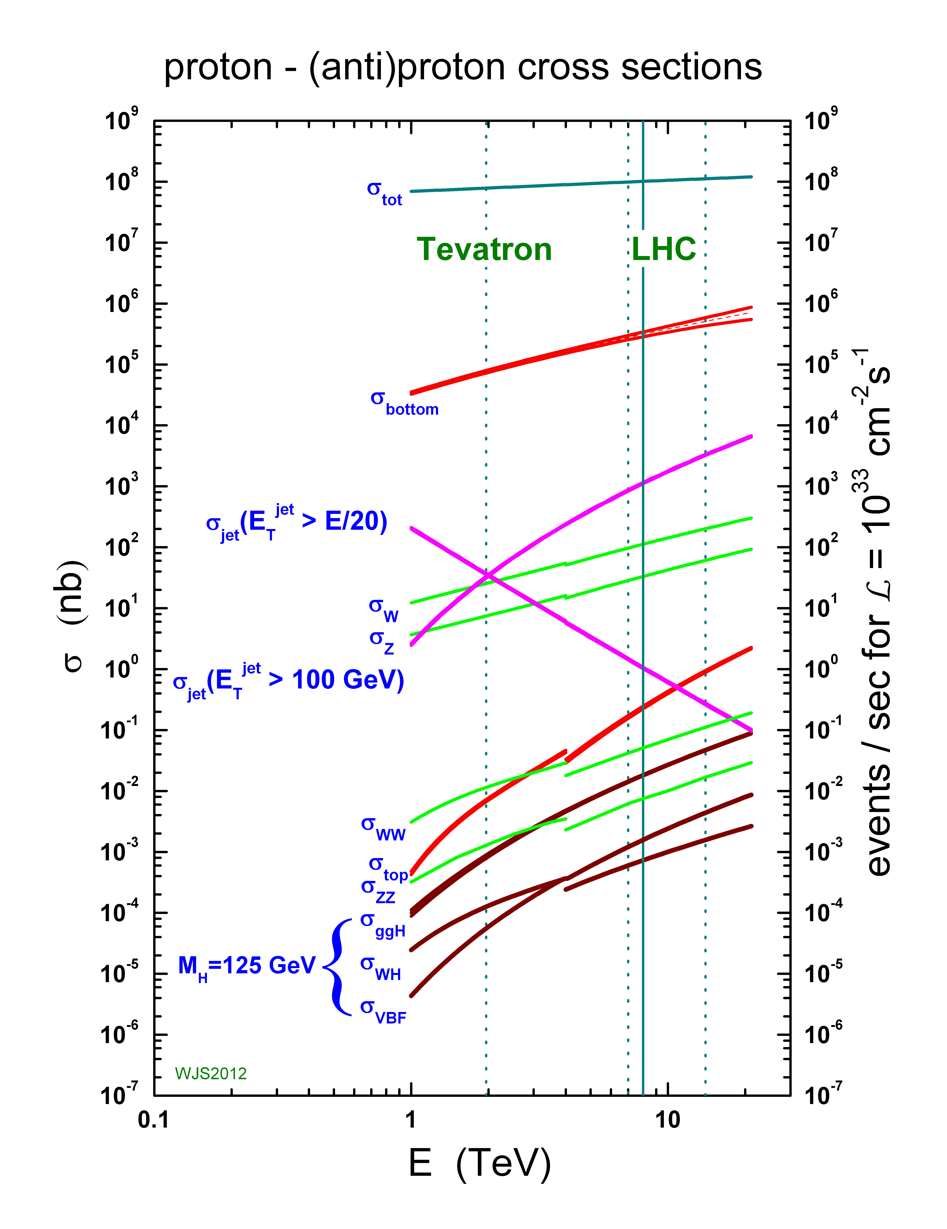
Like "broadband" beams
Collisions at the highest energies are rare
Sensitive to many processes
Interesting processes are rare
A premium on "luminosity" (ie, beam intensity)

Slide 23
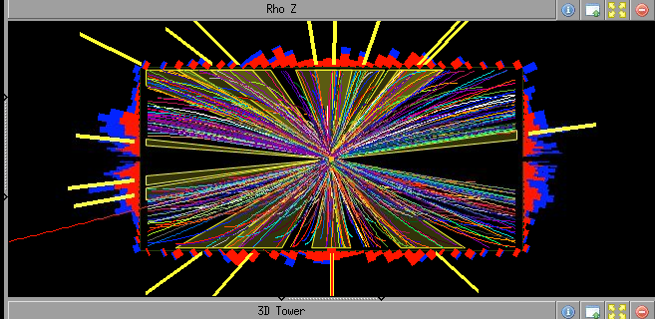
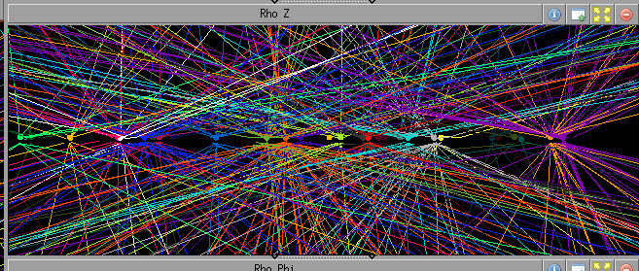

Slide 24
The importance of "the TeV scale"
The LHC was built to investigate physics at the TeV scale
No lose theorem: there has to be new physics at ~ TeV energies
Why?

Slide 25
The questions of particle physics
Matter/antimatter asymmetry in the universe?
Dark matter? Dark energy?
Why 3 generations?
Why are the masses what they are and why are they so different?
How do quarks and leptons and W/Z bosons get their mass? (The Higgs and all that)
Are quarks and leptons really fundamental?
What about gravity?

Slide 26
The question of mass (1)
The Standard Model is a quantum gauge theory that is very successful at describing the strong, week, and EM interactions
It has trouble with masses. Putting mass terms "by hand" in the lagrangian does not work
Need to invent a mechanism for leptons/quarks etc to acquire mass somehow
The Higgs mechanism is one way:
  Postulates the existence of a new field that permeates space
  Postulate some clever way of this field to interact with leptons/quarks/gauge bosons
  Under some circumstances these interactions give rise to the missing mass terms in the lagrangian without breaking the mathematical consistency of the theory

Slide 27
The question of mass (2)
Necessary property of the Higgs field
  Has to have a vacuum expectation value of 0.246 TeV
  Existence of an associated particle of S=0 and mass ~ 0.1 – 1 TeV
Before LHC did not know if Higgs picture was correct
There were other possibilities
  All of involved new particles/new interactions at ~ TeV scale
If Higgs is the answer: what Higgs?
  More than one way to setup "the Higgs sector". Maybe one Higgs boson? Maybe a family?
There must be something going on at the TeV scale

Slide 28
The Higgs
Something that looks very much like the minimal Standard Model Higgs boson was discovered in 2012, Mass ~ 0.125 TeV = 125 GeV
  More on this later
So it is all done? No
The questions of dark matter, generations, etc. remain
All is not well with Higgs

Slide 29
Issues with the Higgs
In the SM the quantum corrections to the Higgs mass are infinitely large, or at least as large at the scale of new physics
M² ≈ M²₀ - Λ²
where Λ is the energy scale of new physics
Know one such scale: the Plank scale, Λ≈10¹⁹ GeV, where quantum mechanics meets gravity.
For Λ≈10¹⁹ GeV, M≈100 GeV, need cancellation to 34 decimal places
More attractive (natural) to expect Λ ≈ 0.1-1 TeV
Even having found a Higgs boson, good reasons to believe that there may be new physics around the corner

Slide 30
An important bonus
Many of the possibilities for new physics include neutral weakly interacting massive particles
  e.g.: supersymmetric theories
Dark matter, "WIMP miracle"
Bottom line: important to search for new physics at the TeV scale. Signatures that include missing energy from dark matter are (to me) the most compelling

Slide 31
Searching for new physics
Searching for new physics:
New particle: if you detect decay products, add four vectors, look at invariant mass

Slide 32
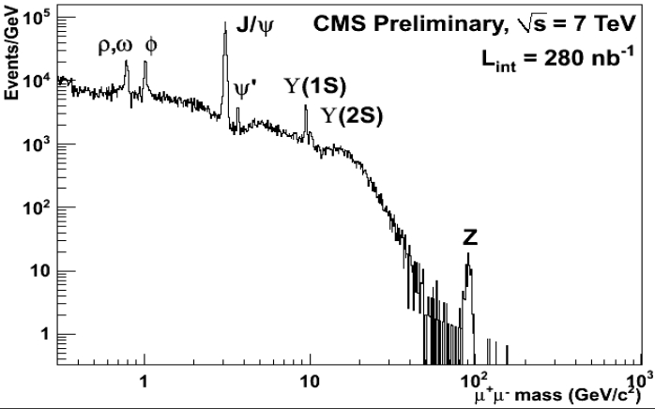
μ⁺μ⁻ invariant mass

Slide 33
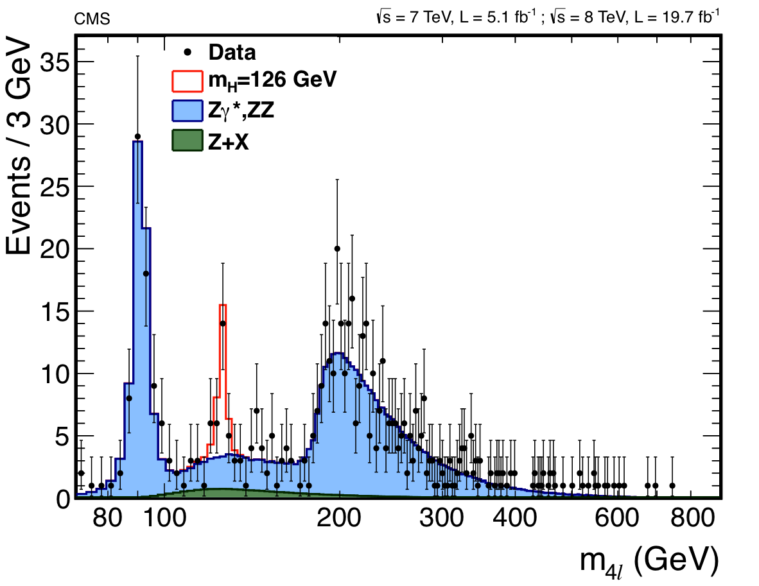
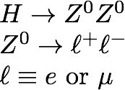

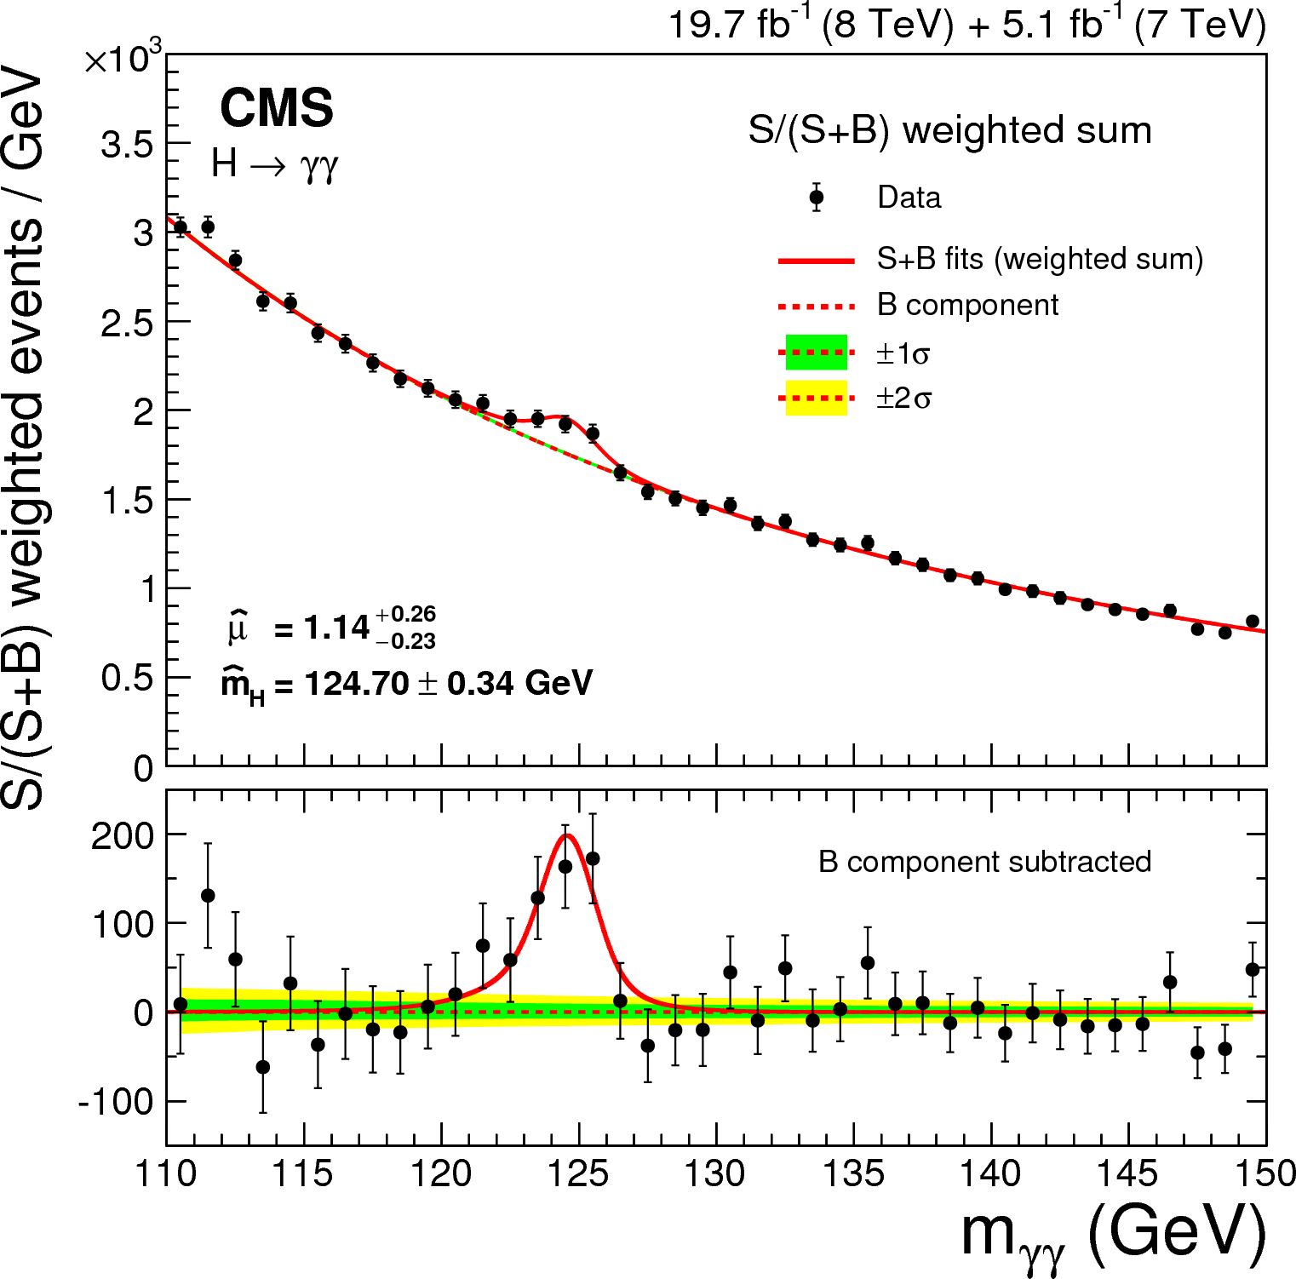
data set corresponds
to ≈ 2.5 10¹⁵ pp interactions

Slide 34
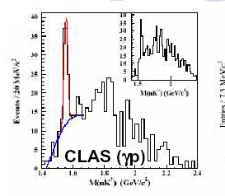
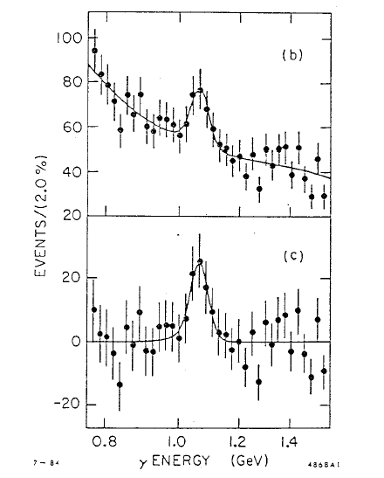
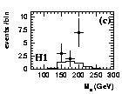
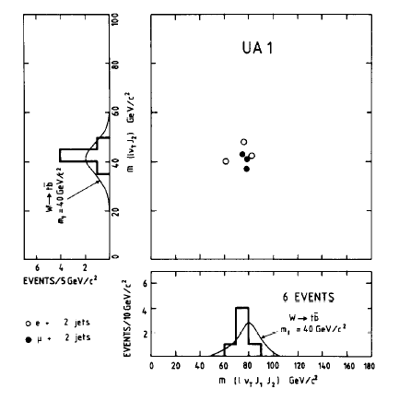
Easy? Yes, but not all that glitters is gold
Pentaquarks
ζ(8.3)
Leptoquarks
40 GeV top
Buyer beware.
Especially in the tails of distributions
More on this later...

Slide 35
Searching for new physics
Searching for new physics:
New particle: if you detect decay products, add four vectors, look at invariant mass
New particle: if you miss some decay products (neutrinos, dark matter...) compare number of detected events and their kinematical distributions with expectations
New interactions: ~ same as new particle with missing decay products

Slide 36
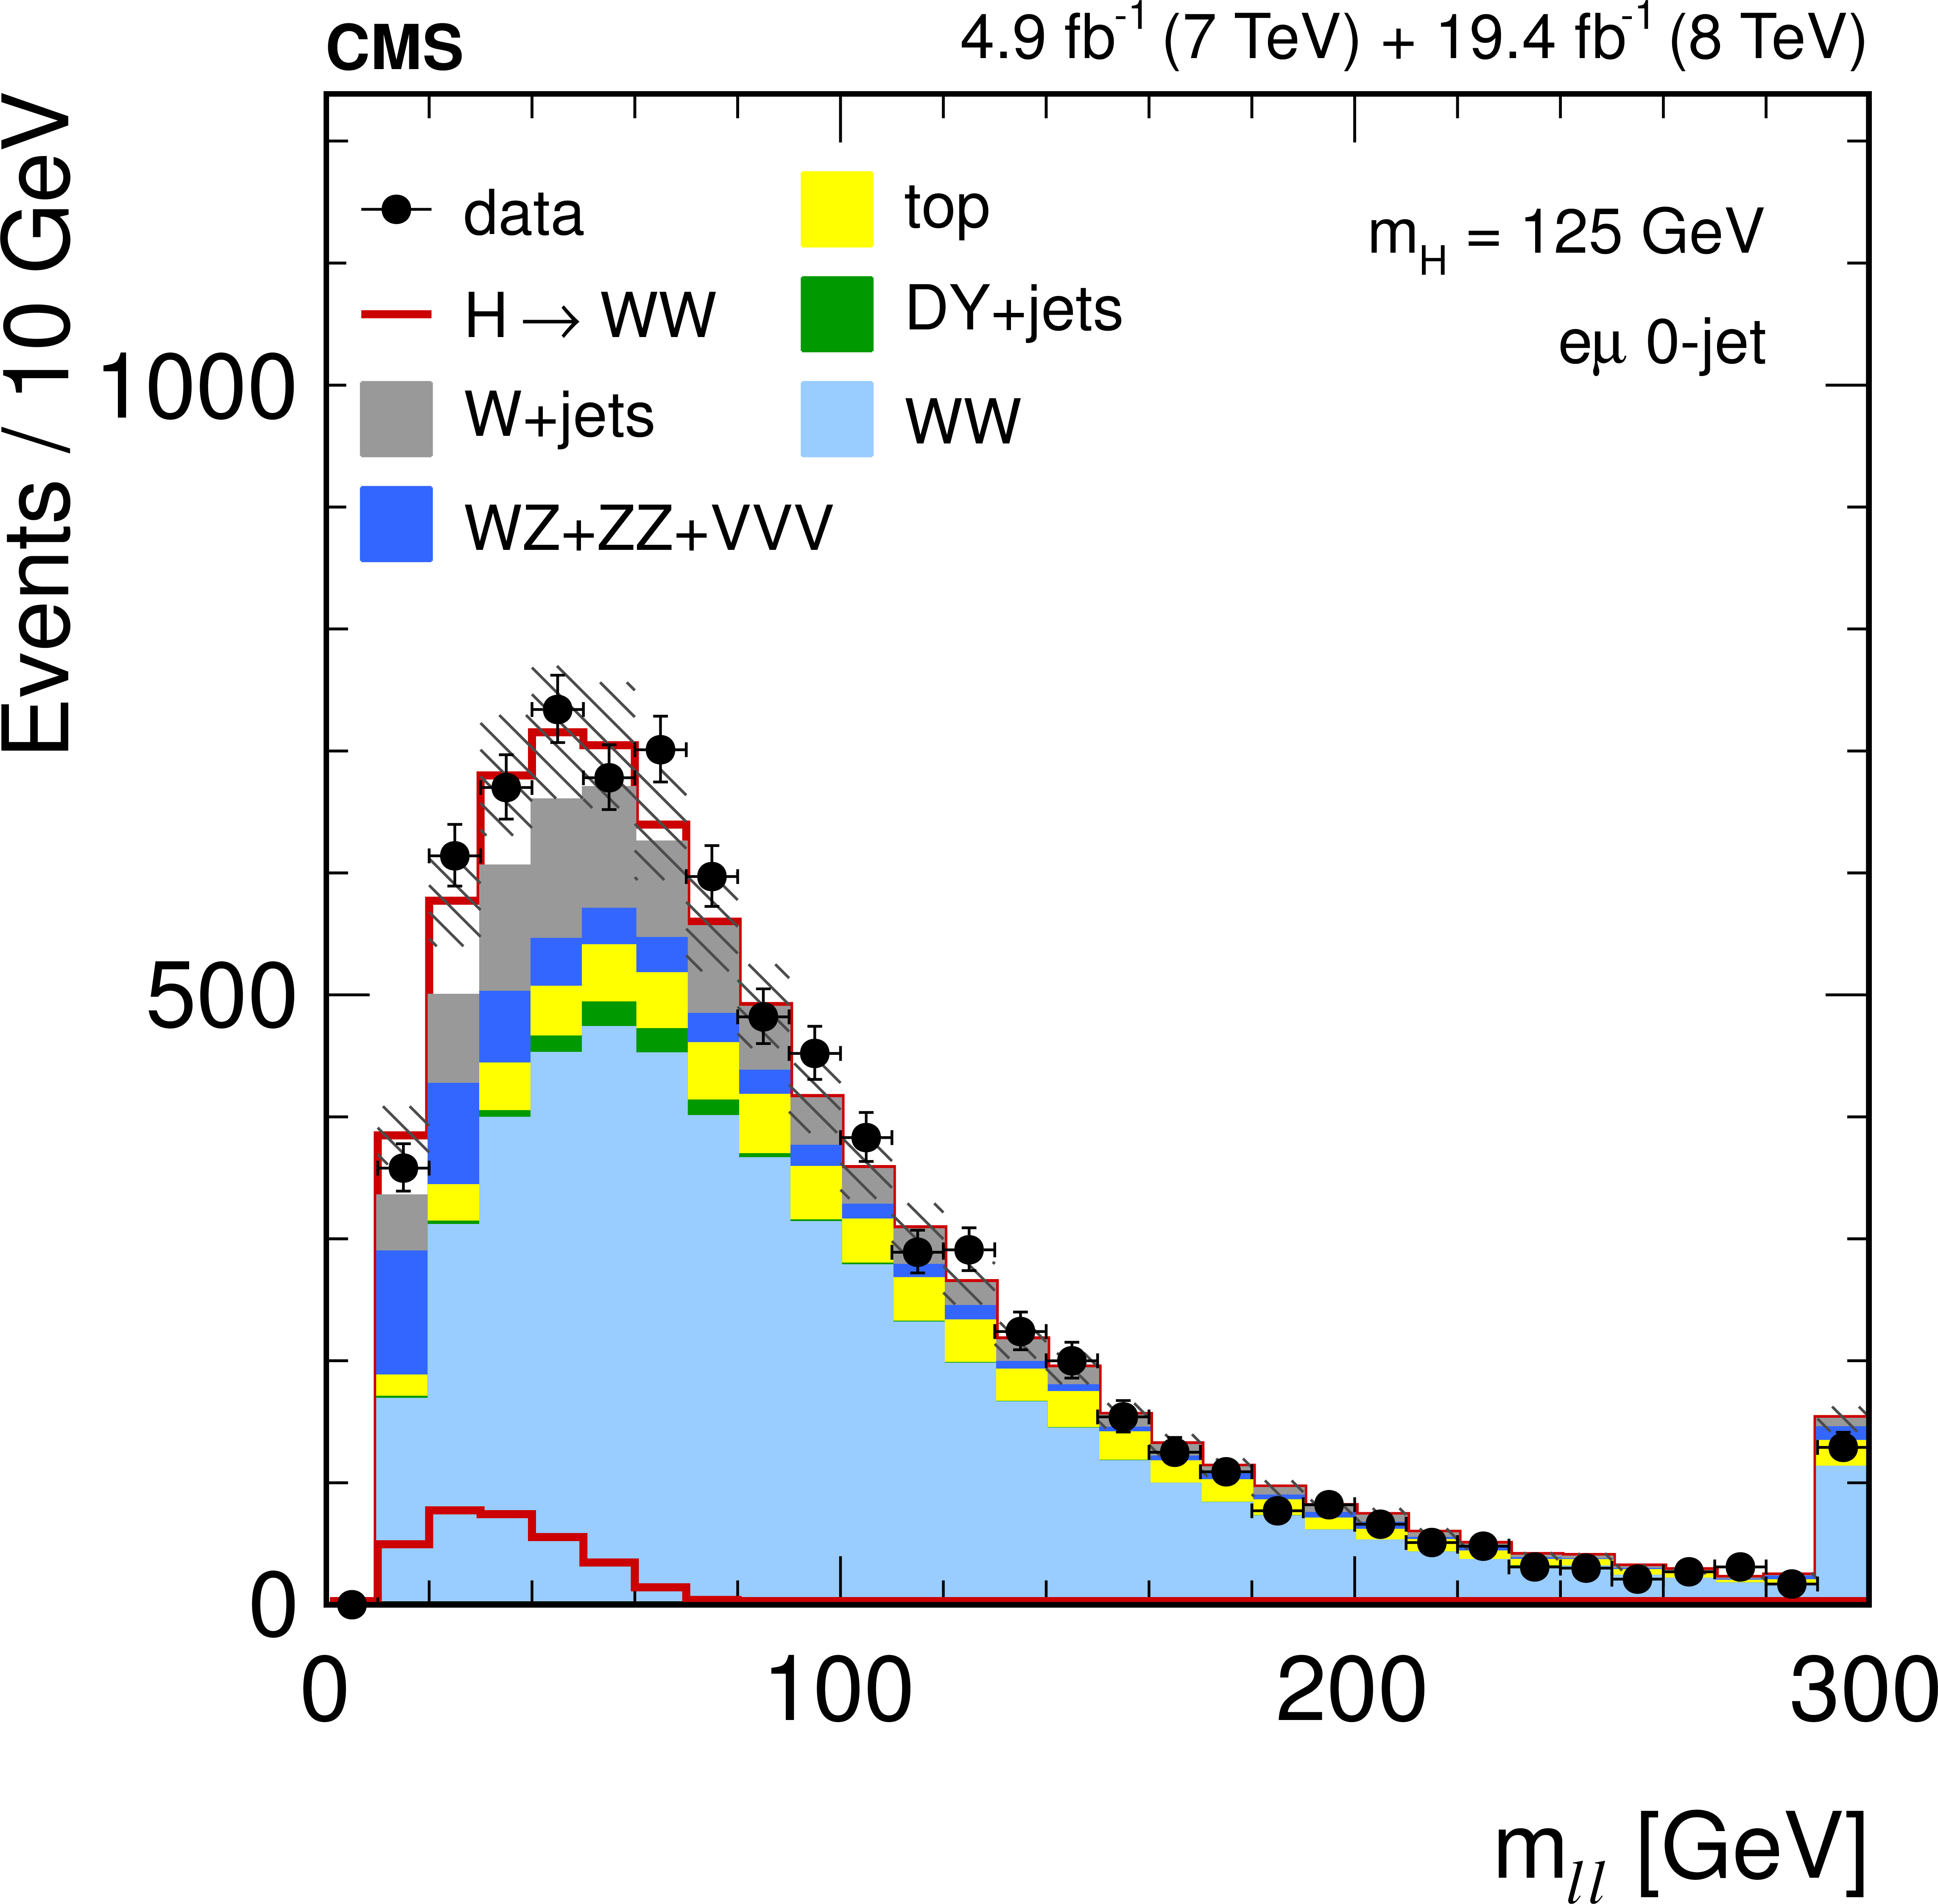
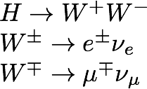

Slide 37
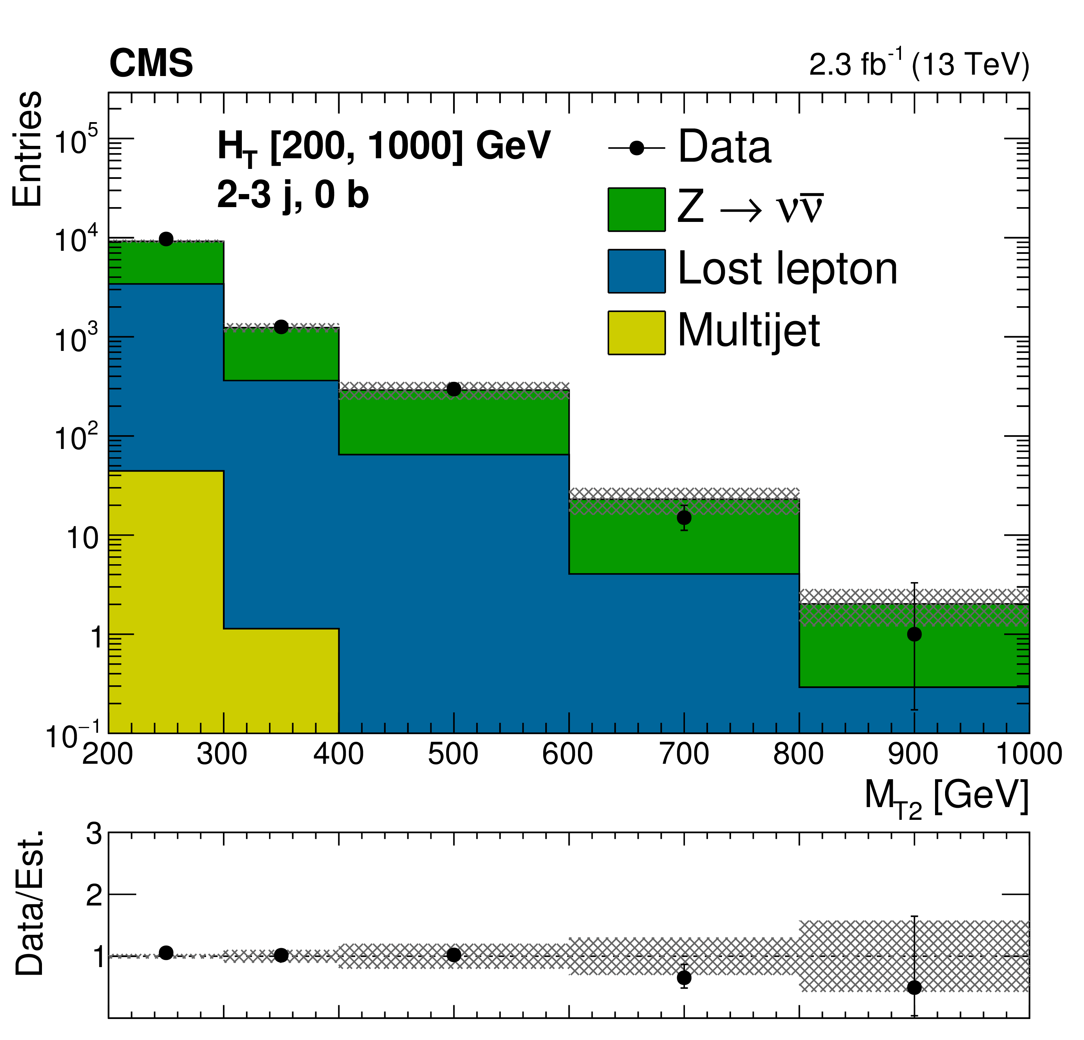
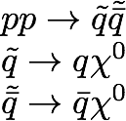
≈ missing energy

Slide 38
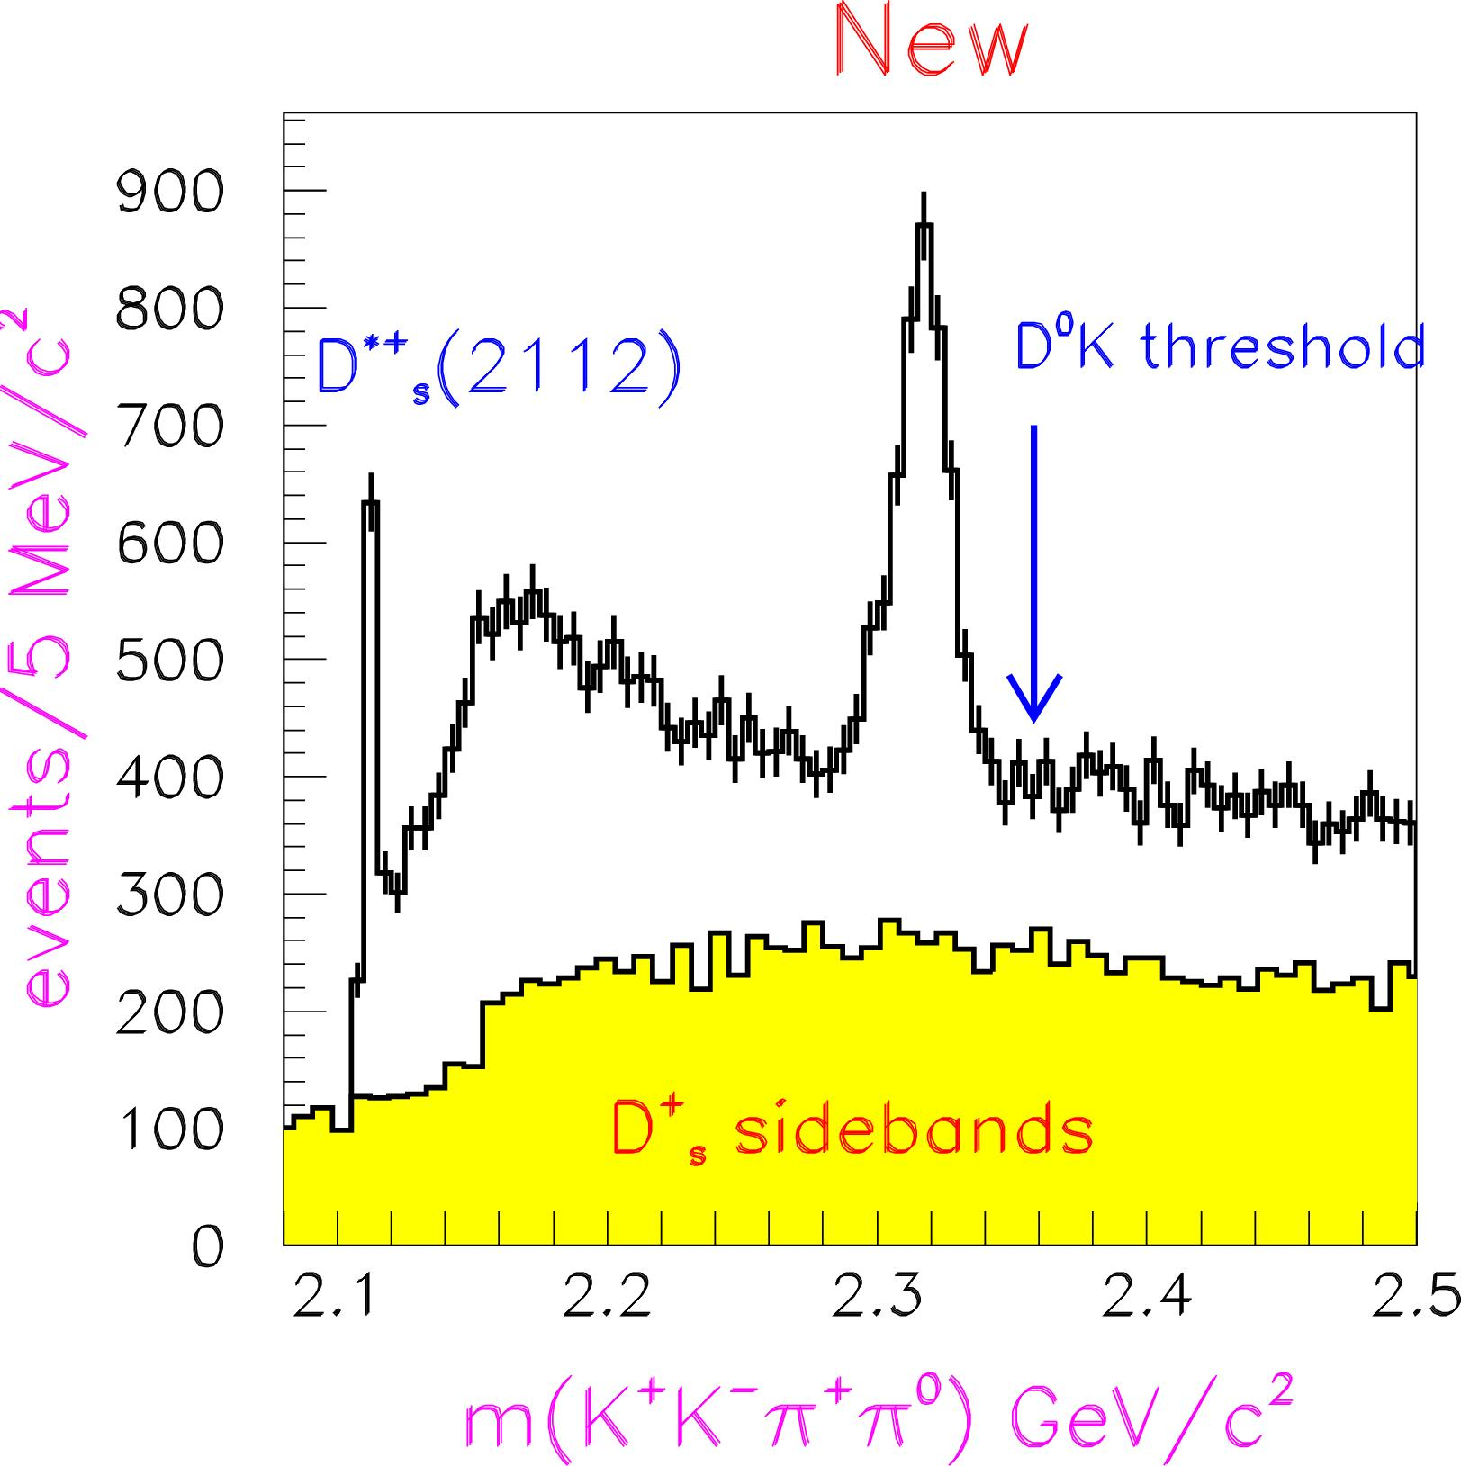
We can only find what we look for.....
BaBar
Palano (Bari)
D_{sJ}(2317) →D_{S} π⁰
PRL90 242001 (2003)
This huge signal had been in various data sets
for many years.
Worry about "trigger"

Slide 39
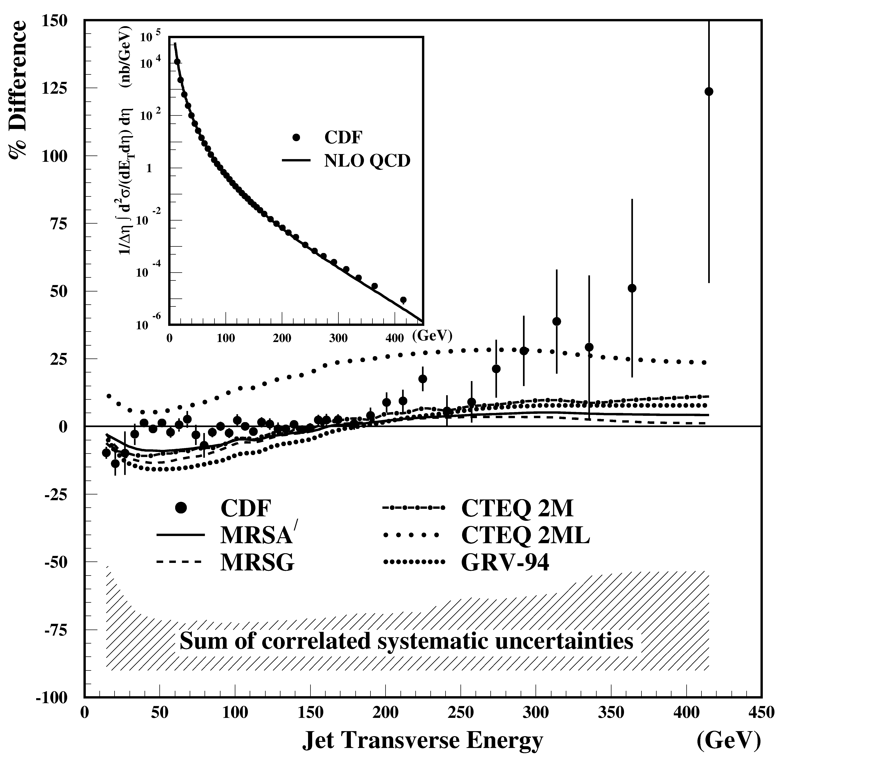
Experiment-theory synergy
Finding new physics requires careful experimental work
And precise calculations of SM processes.
The "excess" at right is exactly what we expect if quarks were composite objects
  Rutherford scattering again!
Further analysis found that the it could be explained by the uncertainties in the parton luminosities
  There was no quantitative measure of those uncertainties in 1996
  There is now
CDF PRL 77
438 (1996)

Slide 40
Where are we now

Slide 41
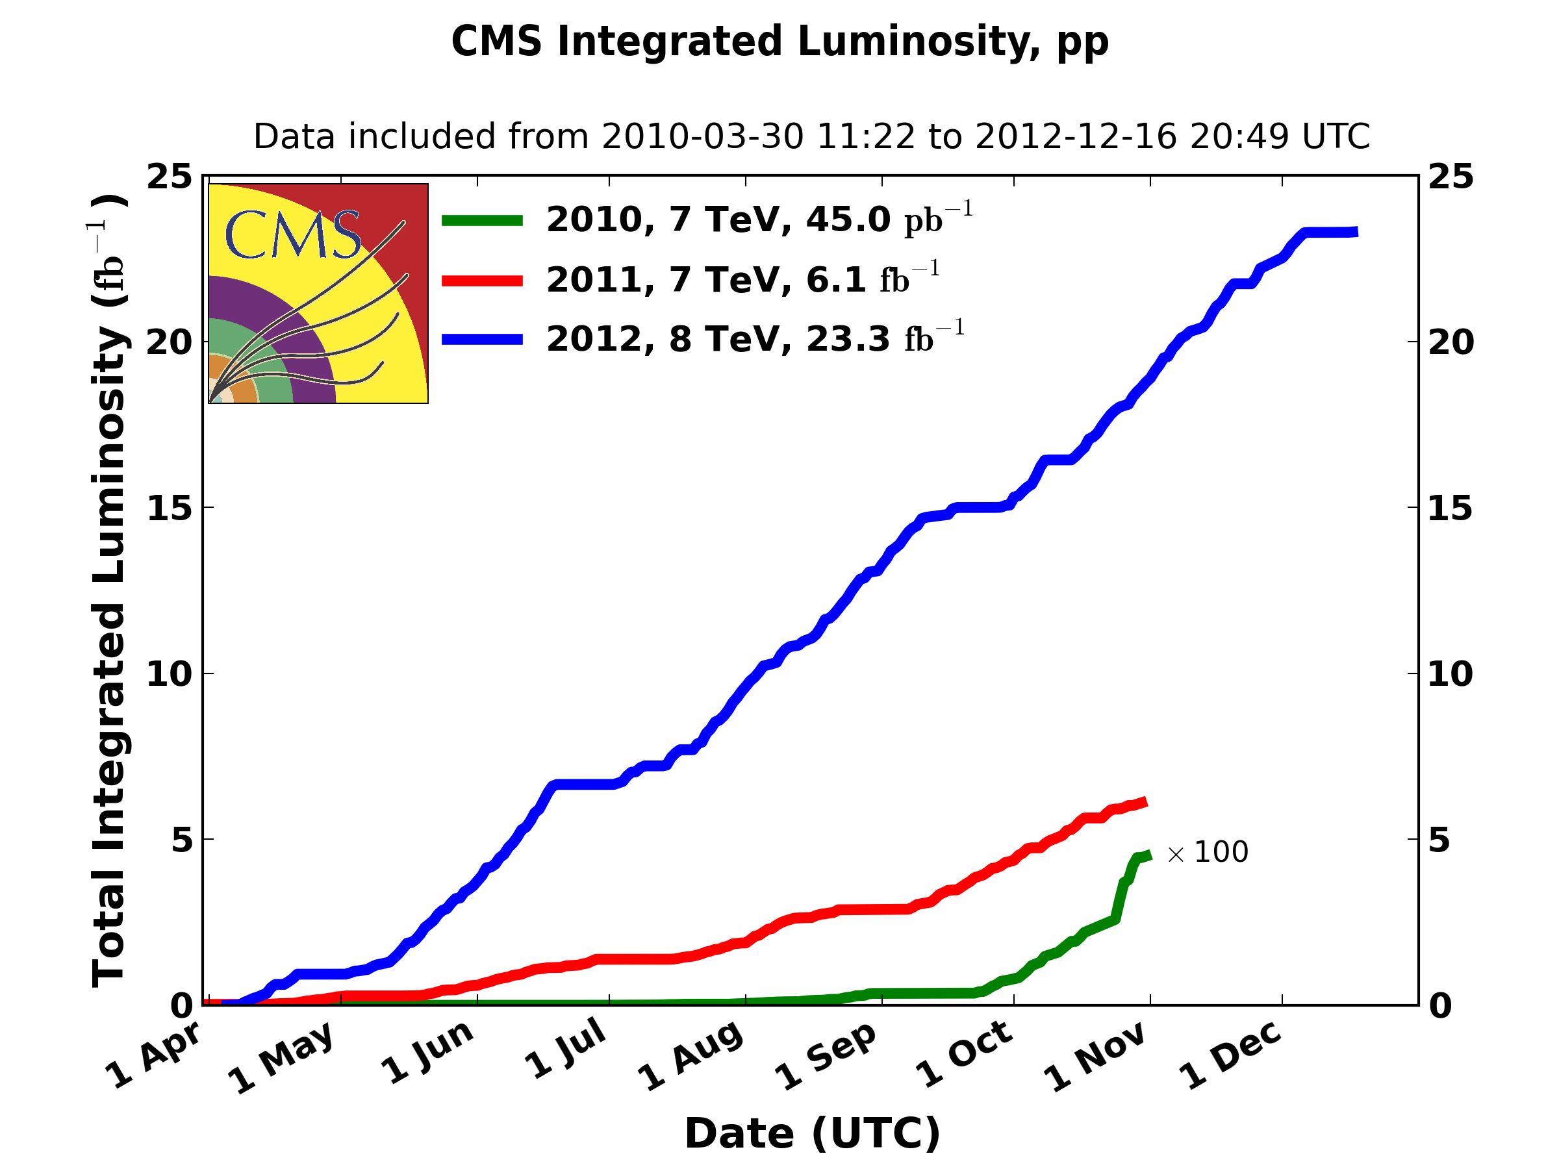
Took data in 2010-2012 at 7-8 TeV
8 TeV: 19.5 fb⁻¹ for analysis

Slide 42
...found a Higgs boson...

Slide 43
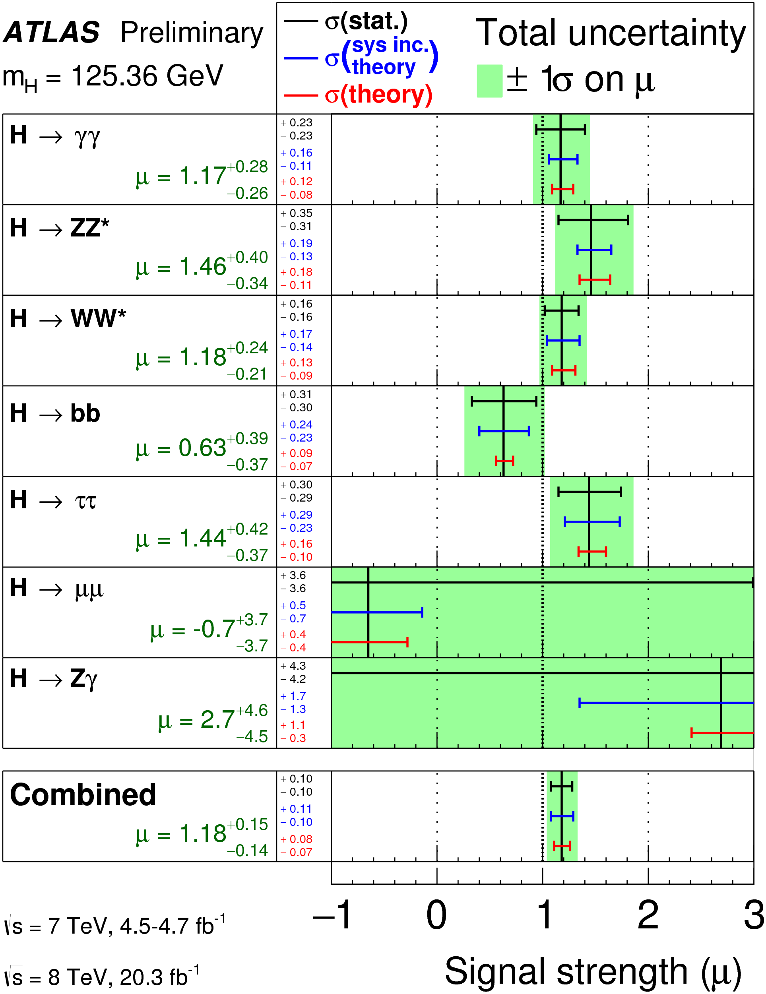
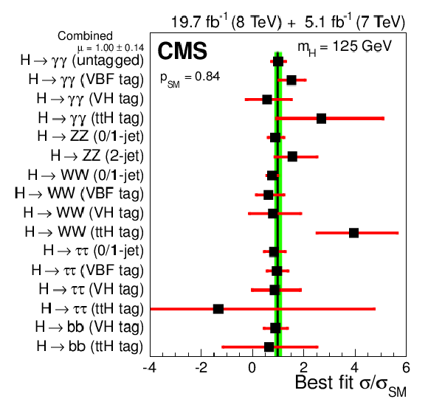
...its properties are consistent with minimal
SM expectations.... but not very precise ...

Slide 44
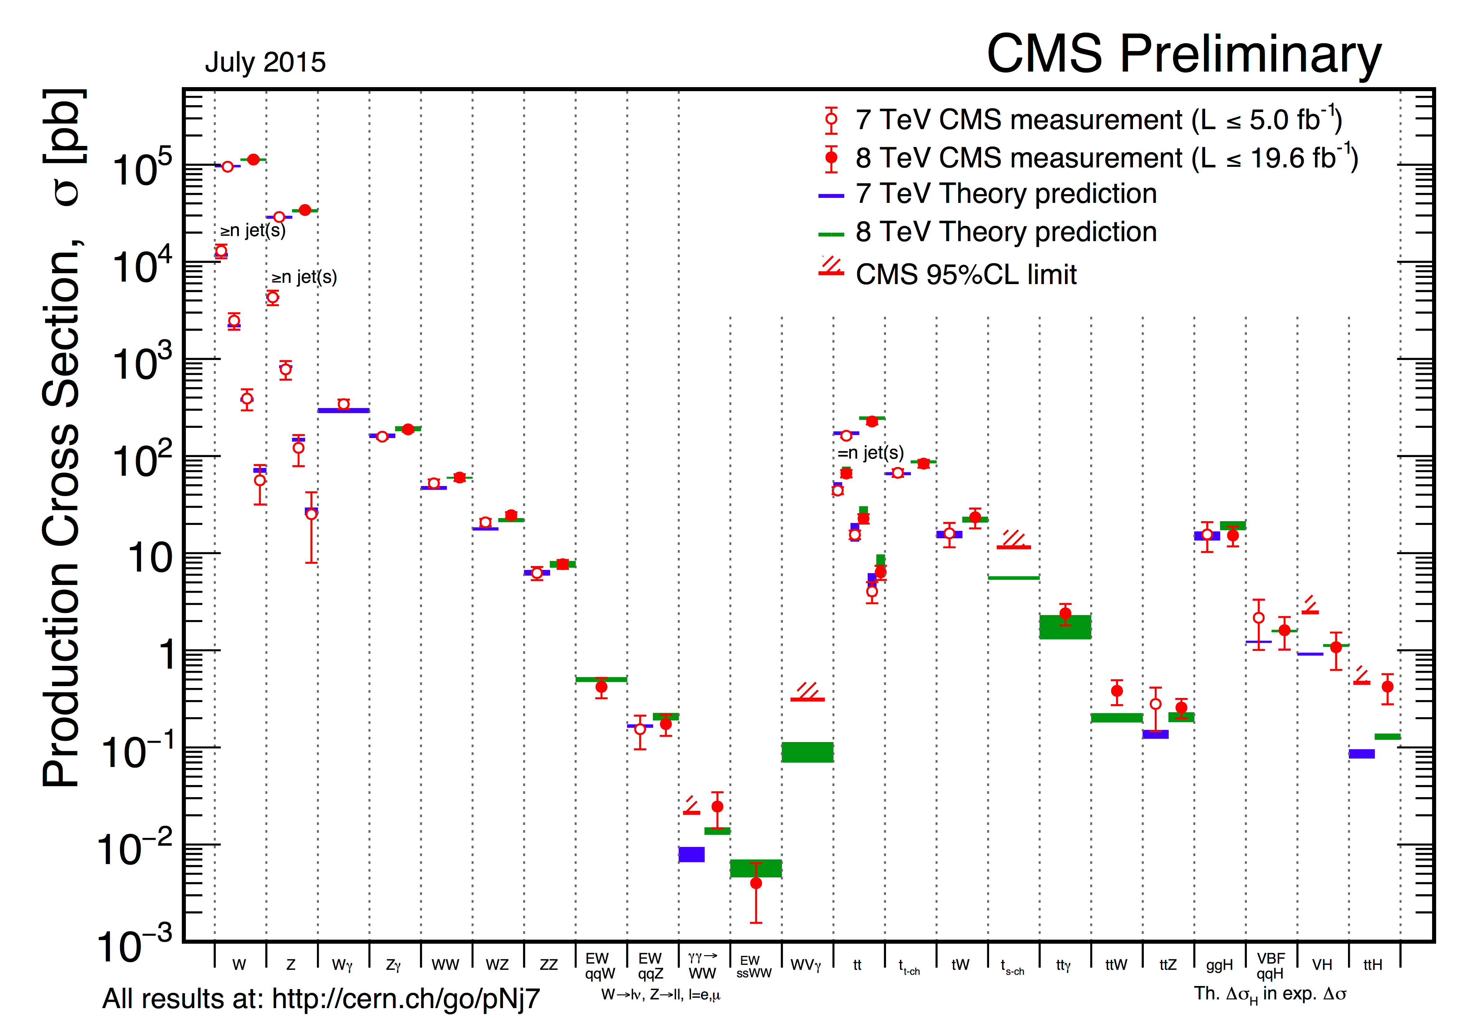
...many measurements of SM processes...

Slide 45
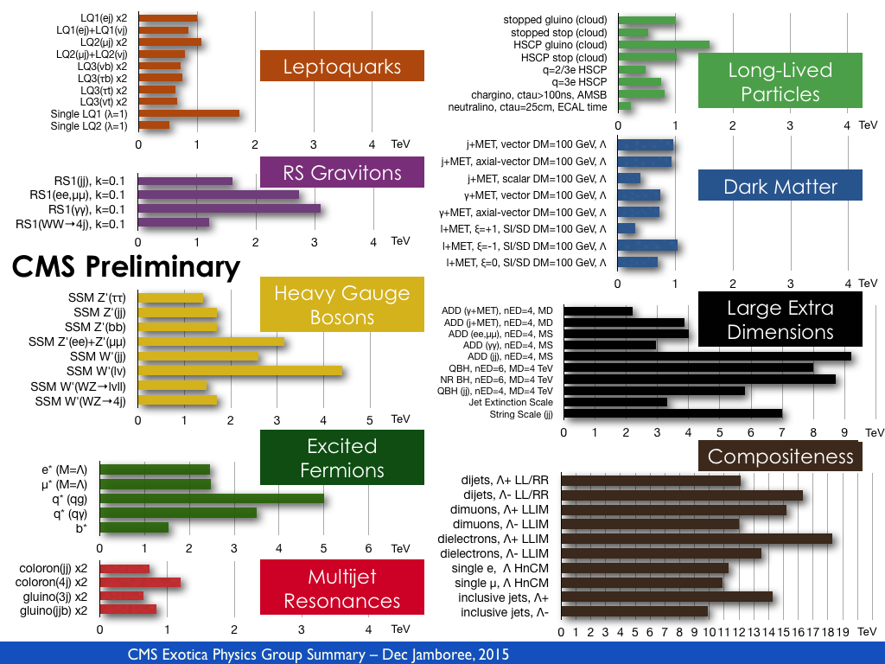
...looked for all sorts of new physics...set limits...

Slide 46





...more limits...

Slide 47
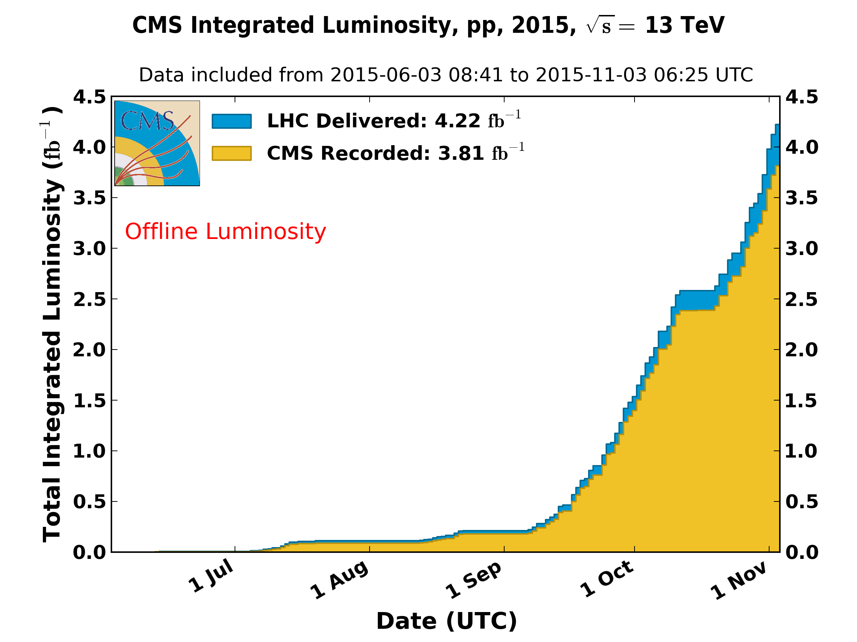
The 2015 LHC Run: 13 TeV
Recorded at B=3.8 T: 2.9 fb⁻¹
3.8 T and all detectors good: 2.3 fb⁻¹
Reminder: 8 TeV, 19.5 fb⁻¹

Slide 48

2.3 fb⁻¹ @ 13 TeV vs. 19.5 fb⁻¹ @ 8 TeV
WJ Stirling, private communication
19.5/2.3=8.4
Center of mass energy (GeV)
Expect improvements in searches for new physics at > 1000 GeV
Not much for Higgs (Mass=125 GeV)

Slide 49
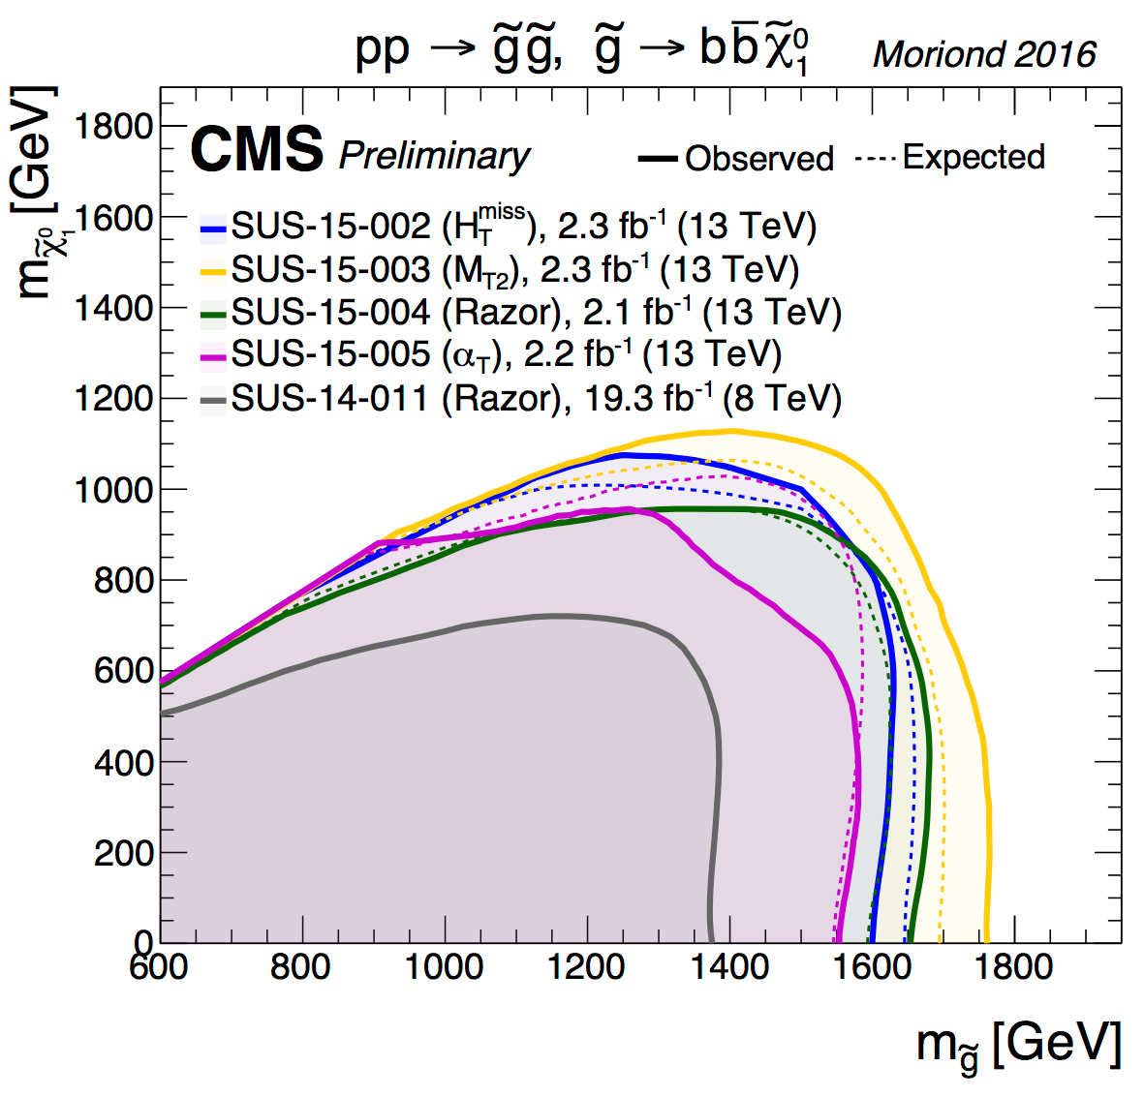
...indeed we improved some limits...

Slide 50
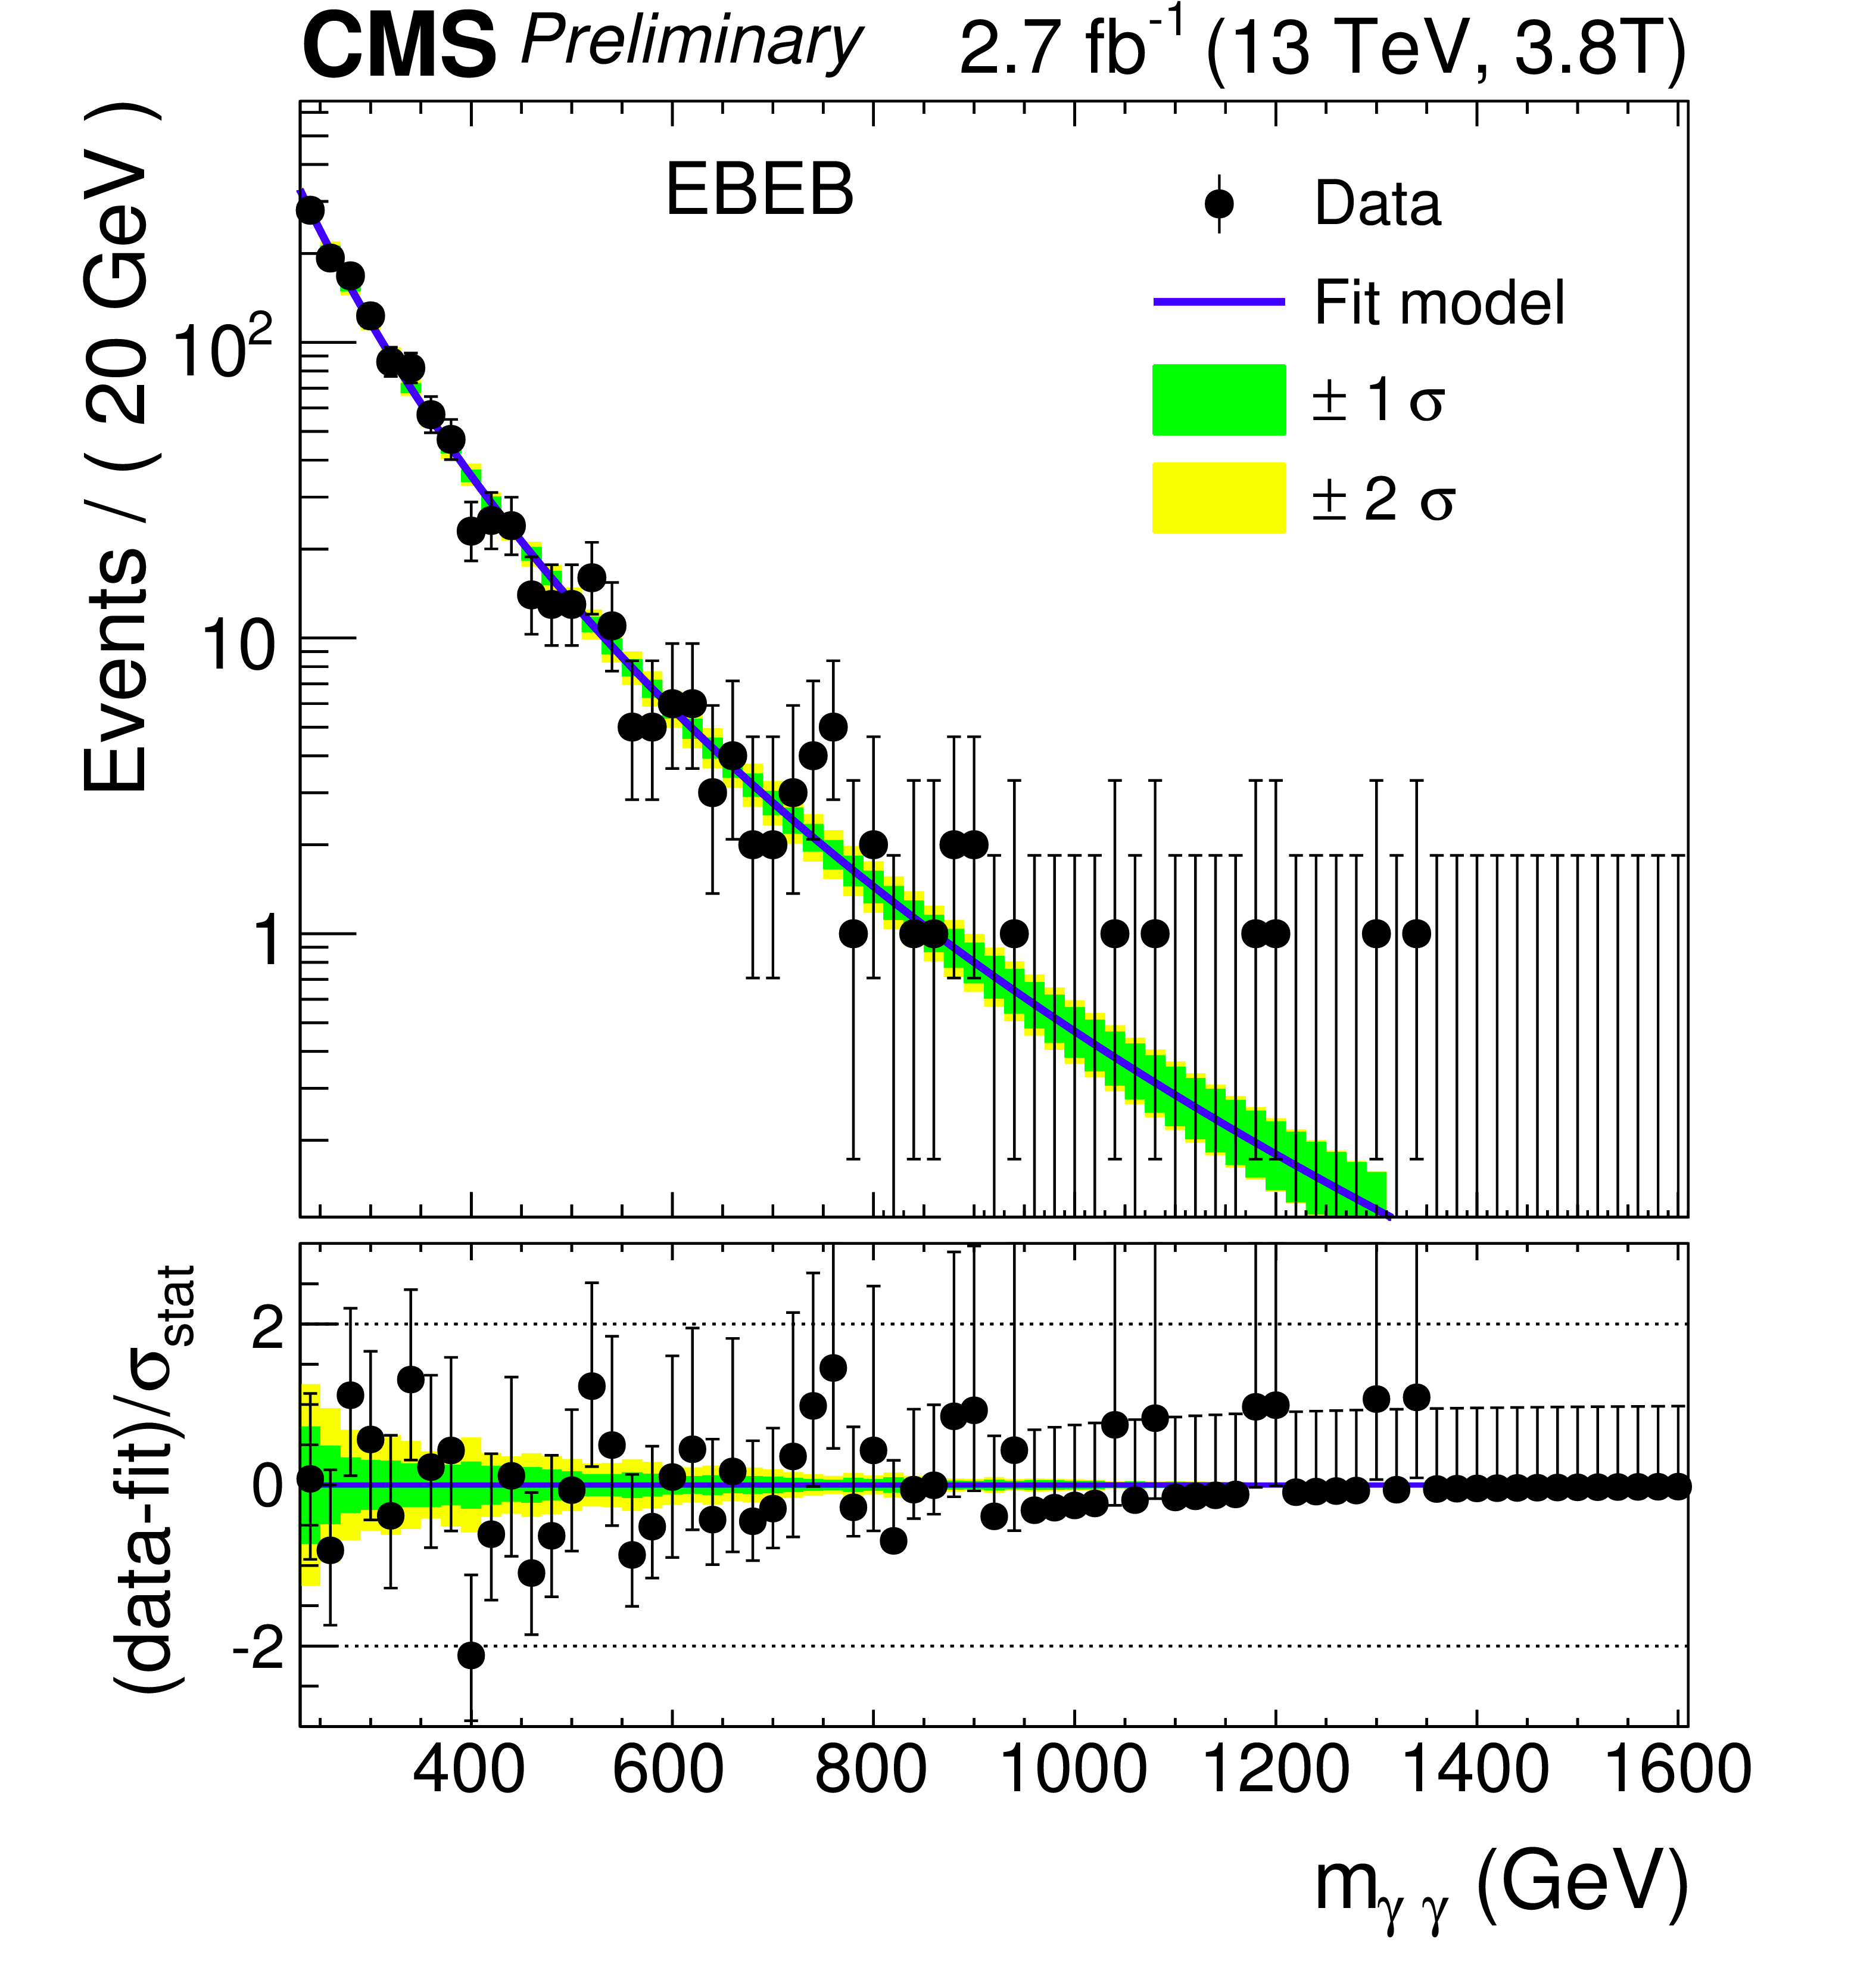
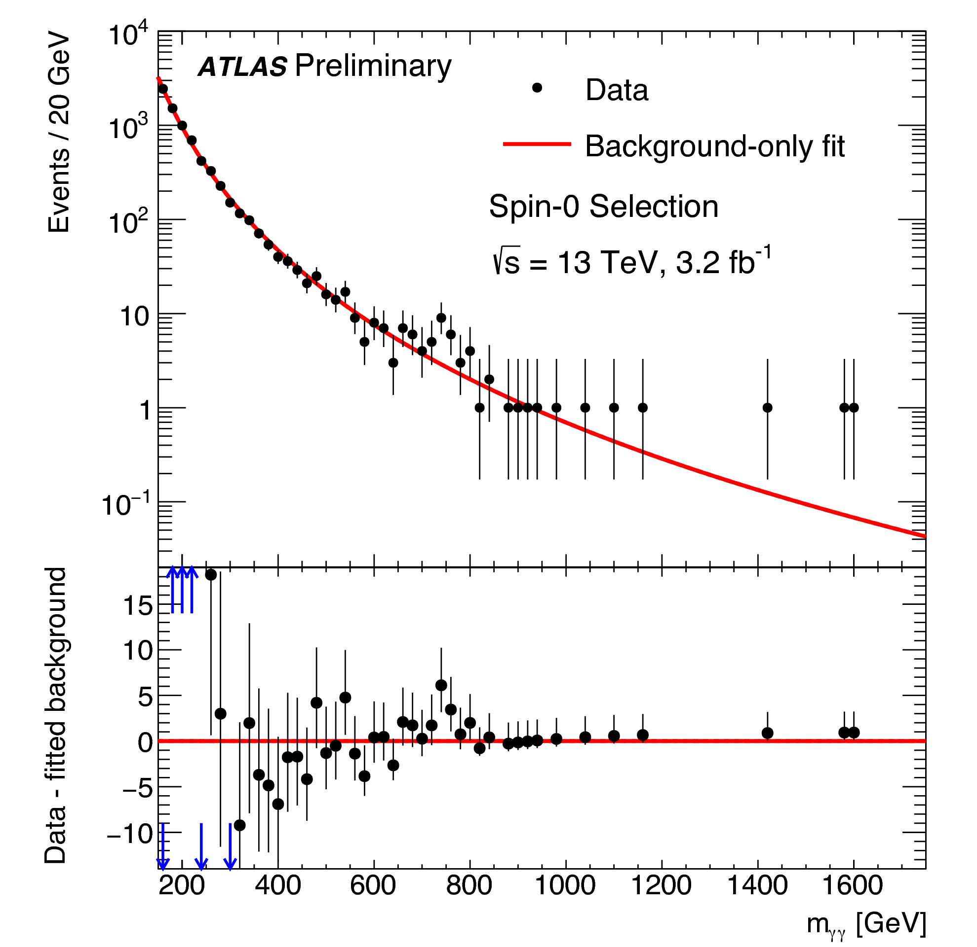
A surprise: diphoton mass bump near 750 GeV?

Slide 51
Questions
Is it real or a statistical fluke?
  We will know by this summer

Slide 52
Questions
Is it real or a statistical fluke?
  We will know by this summer
Are Atlas and CMS consistent with each other
  Yes, within poor statistics

Slide 53
Questions
Is it real or a statistical fluke?
  We will know by this summer
Are Atlas and CMS consistent with each other
  Yes, within poor statistics
You did not see anything much at 8 TeV with x7 more collisions. Does that make any sense?
  Yes, sort of. The gluon-gluon luminosities at 750 GeV give a x5 boost to the production rate

Slide 54
Questions
Is it real or a statistical fluke?
  We will know by this summer
Are Atlas and CMS consistent with each other
  Yes, within poor statistics
You did not see anything much at 8 TeV with x7 more collisions. Does that make any sense?
  Yes, sort of. The gluon-gluon luminosities at 750 GeV give a x5 boost to the production rate
Do the events with diphotons at 750 GeV look special, is there a sign of anything else being produced in association with this bump?
  Not really....but poor statistics

Slide 55
Questions
Is it real or a statistical fluke?
  We will know by this summer
Are Atlas and CMS consistent with each other
  Yes, within poor statistics
You did not see anything much at 8 TeV with x7 more collisions. Does that make any sense?
  Yes, sort of. The gluon-gluon luminosities at 750 GeV give a x5 boost to the production rate
Do the events with diphotons at 750 GeV look special, is there a sign of anything else being produced in association with this bump?
  Not really....but poor statistics
If it is real, what is it
  Nobody really knows

Slide 56
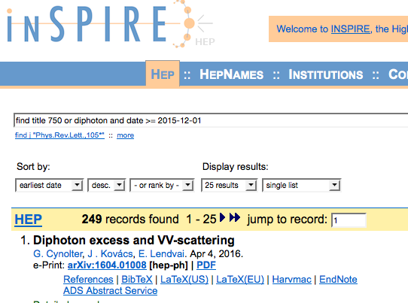

Slide 57
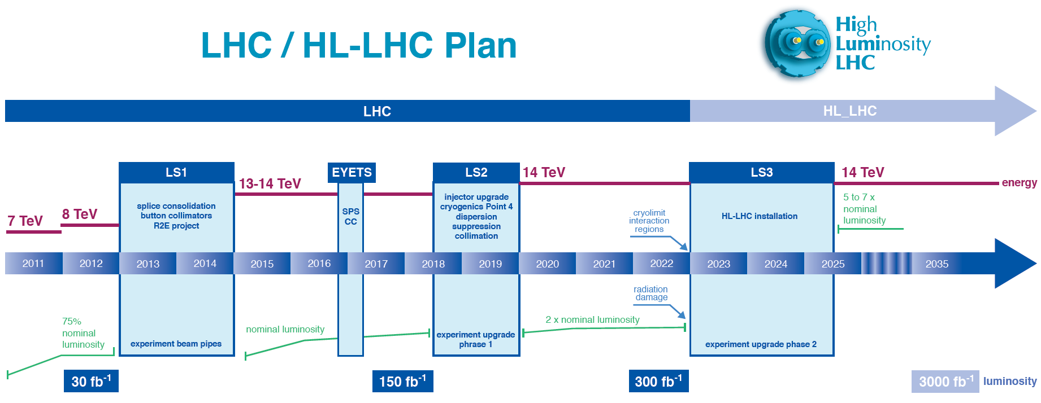
Conclusion
The exploration of the TeV scale at the LHC is in full swing
By this summer we will know if the 750 GeV object is real or a fluke

Slide 58
Bonus slides

Slide 59
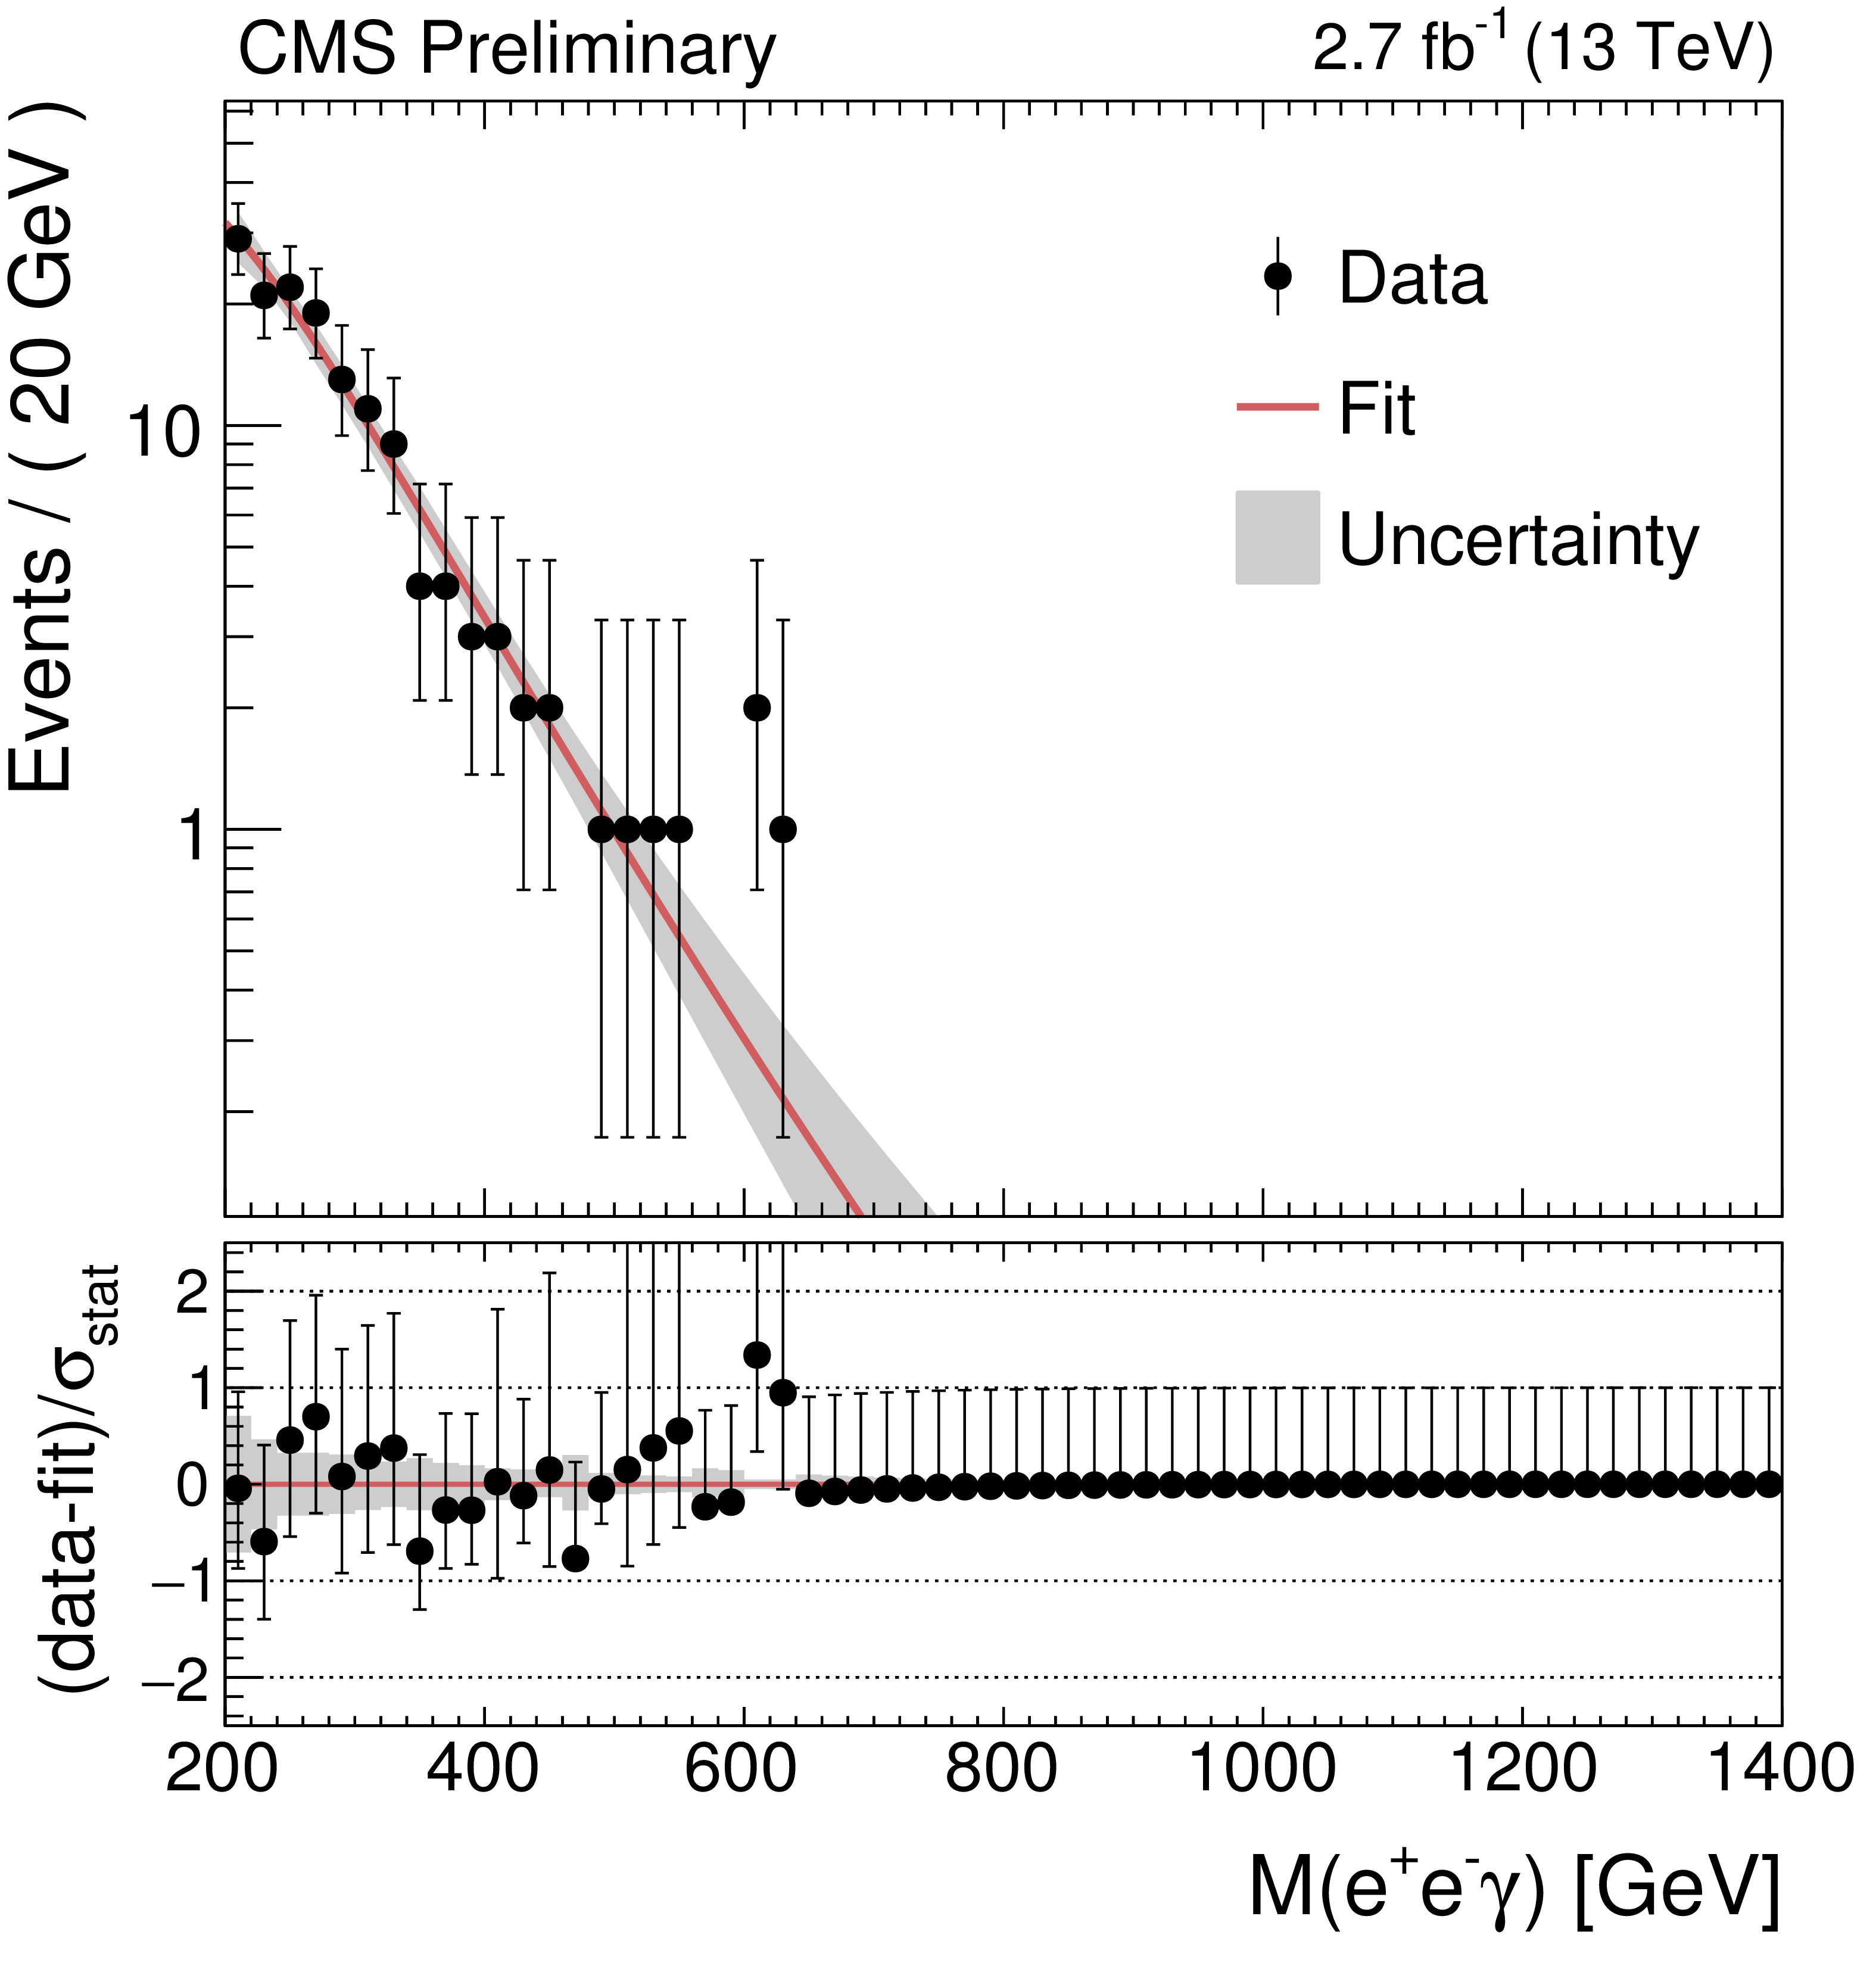
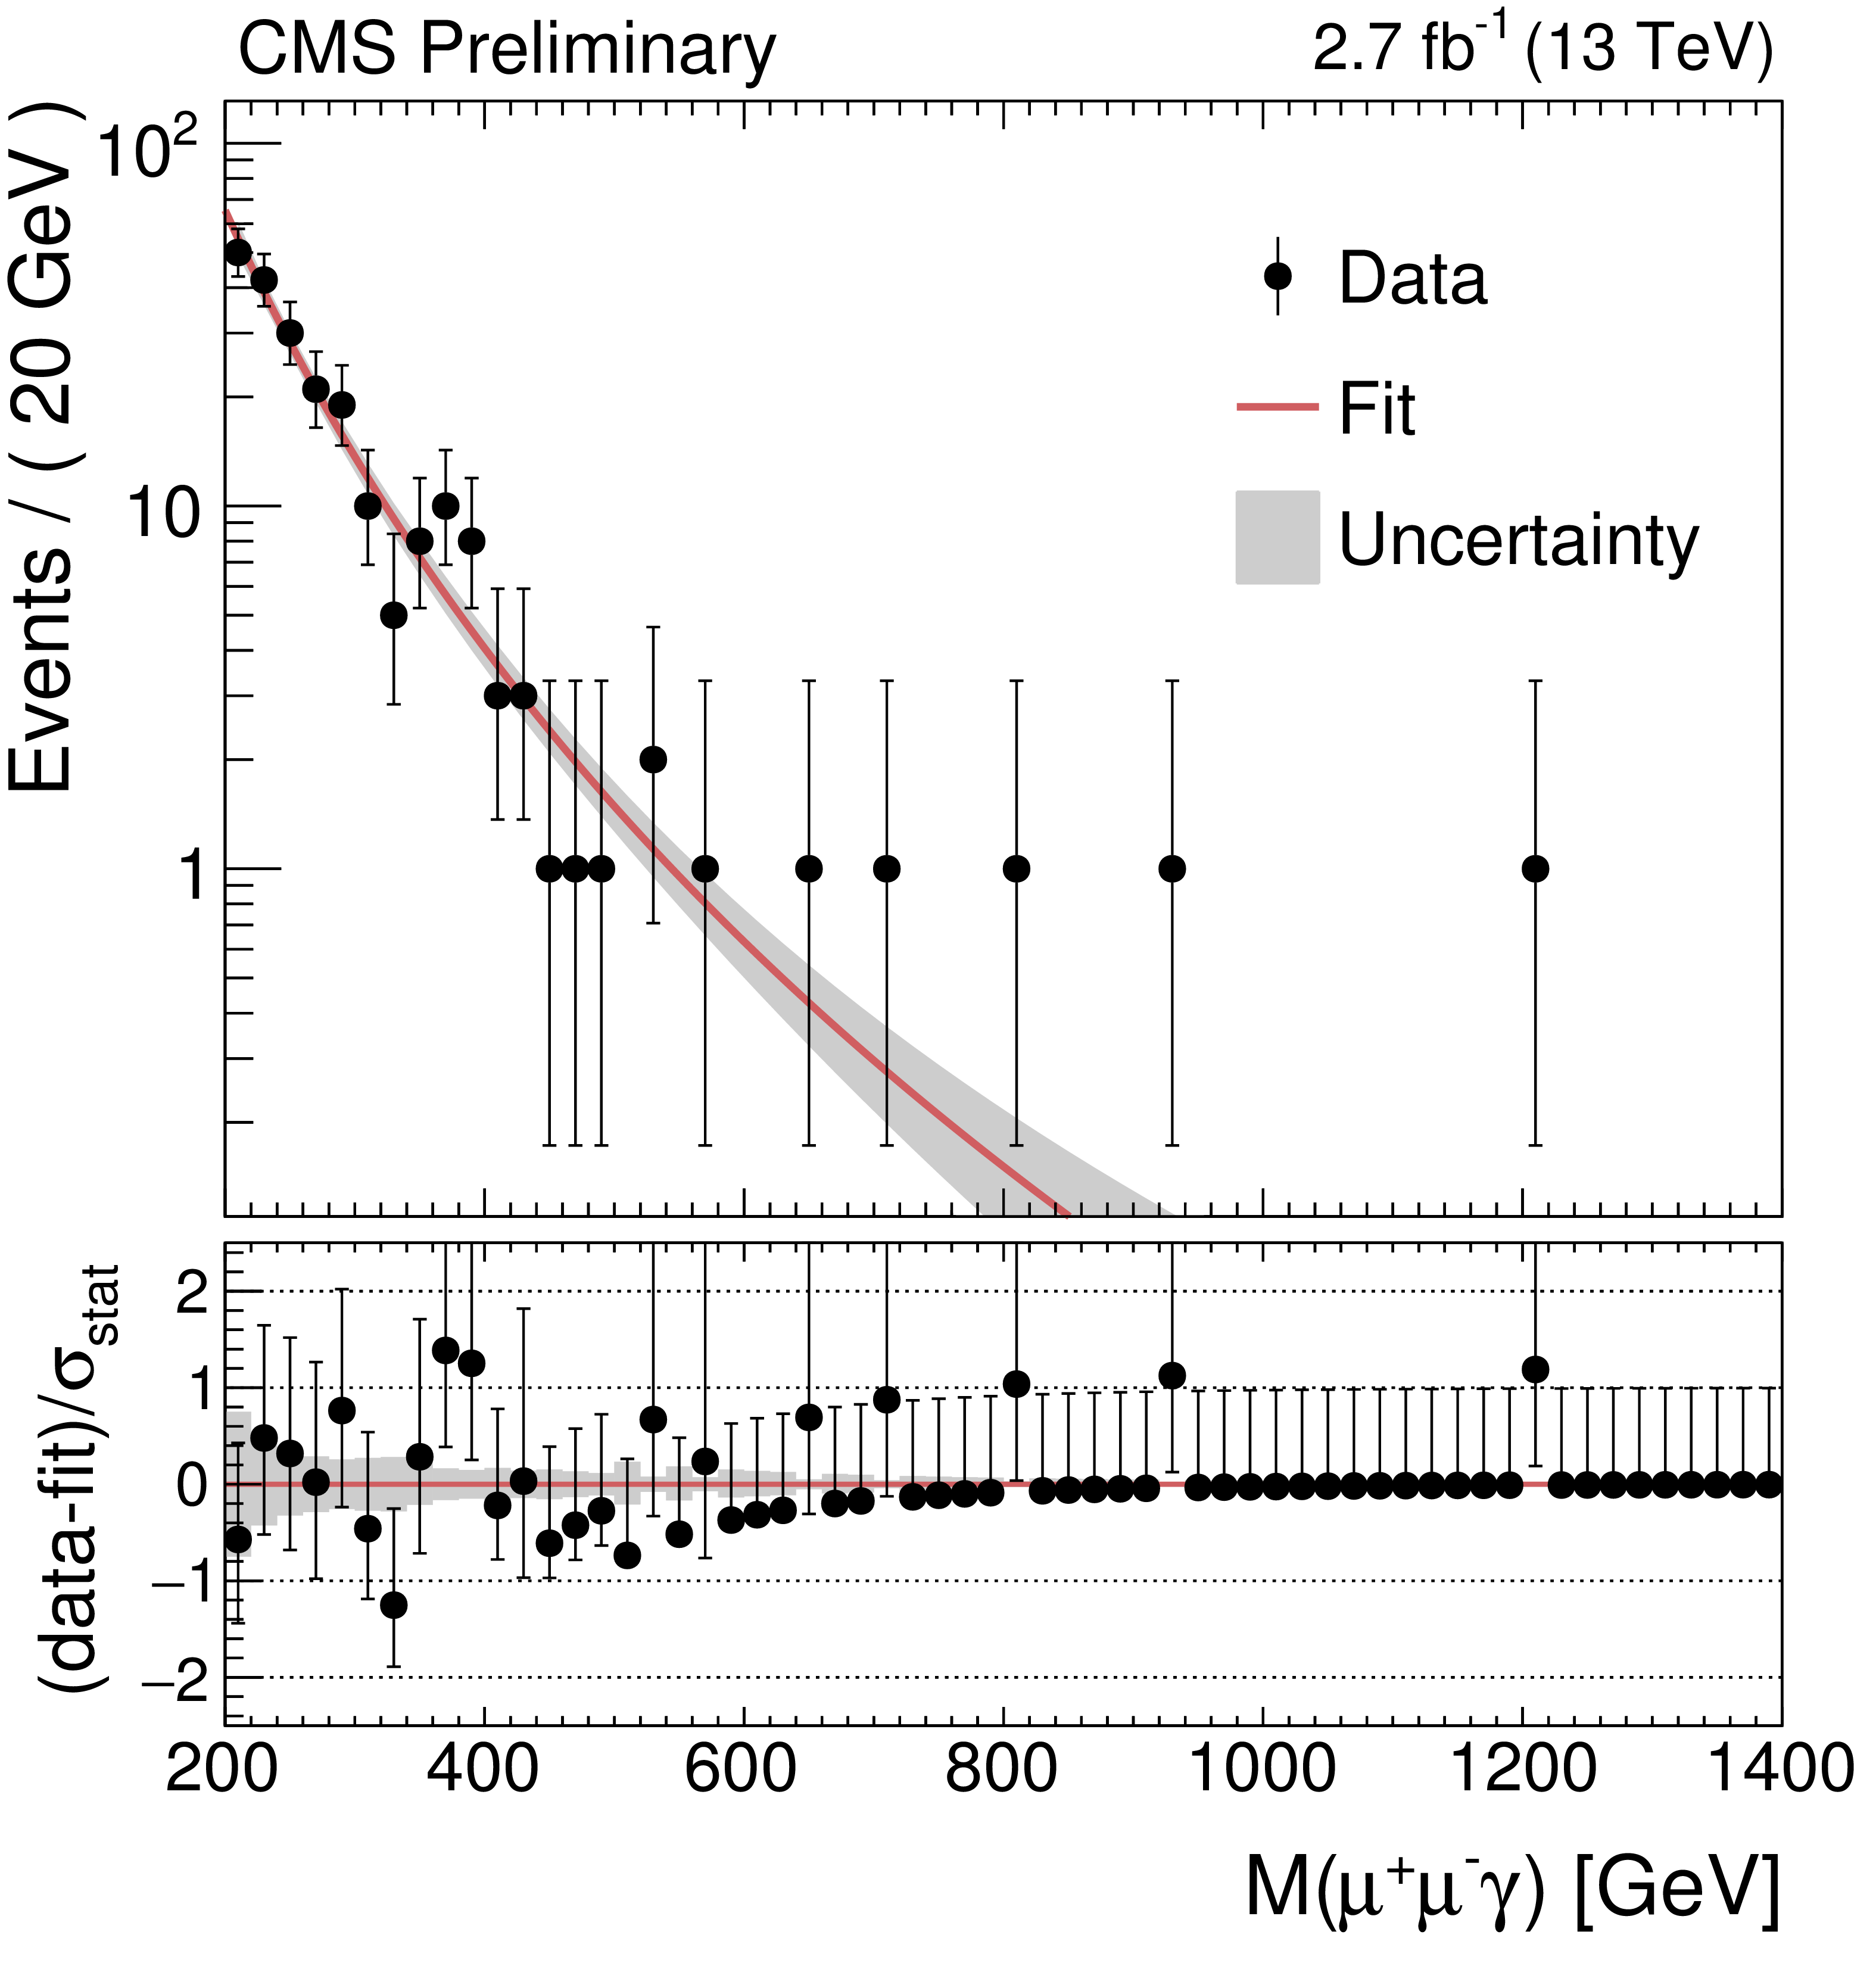
Other channels? Zγ?
CMS-PAS-EXO-16-019

Slide 60
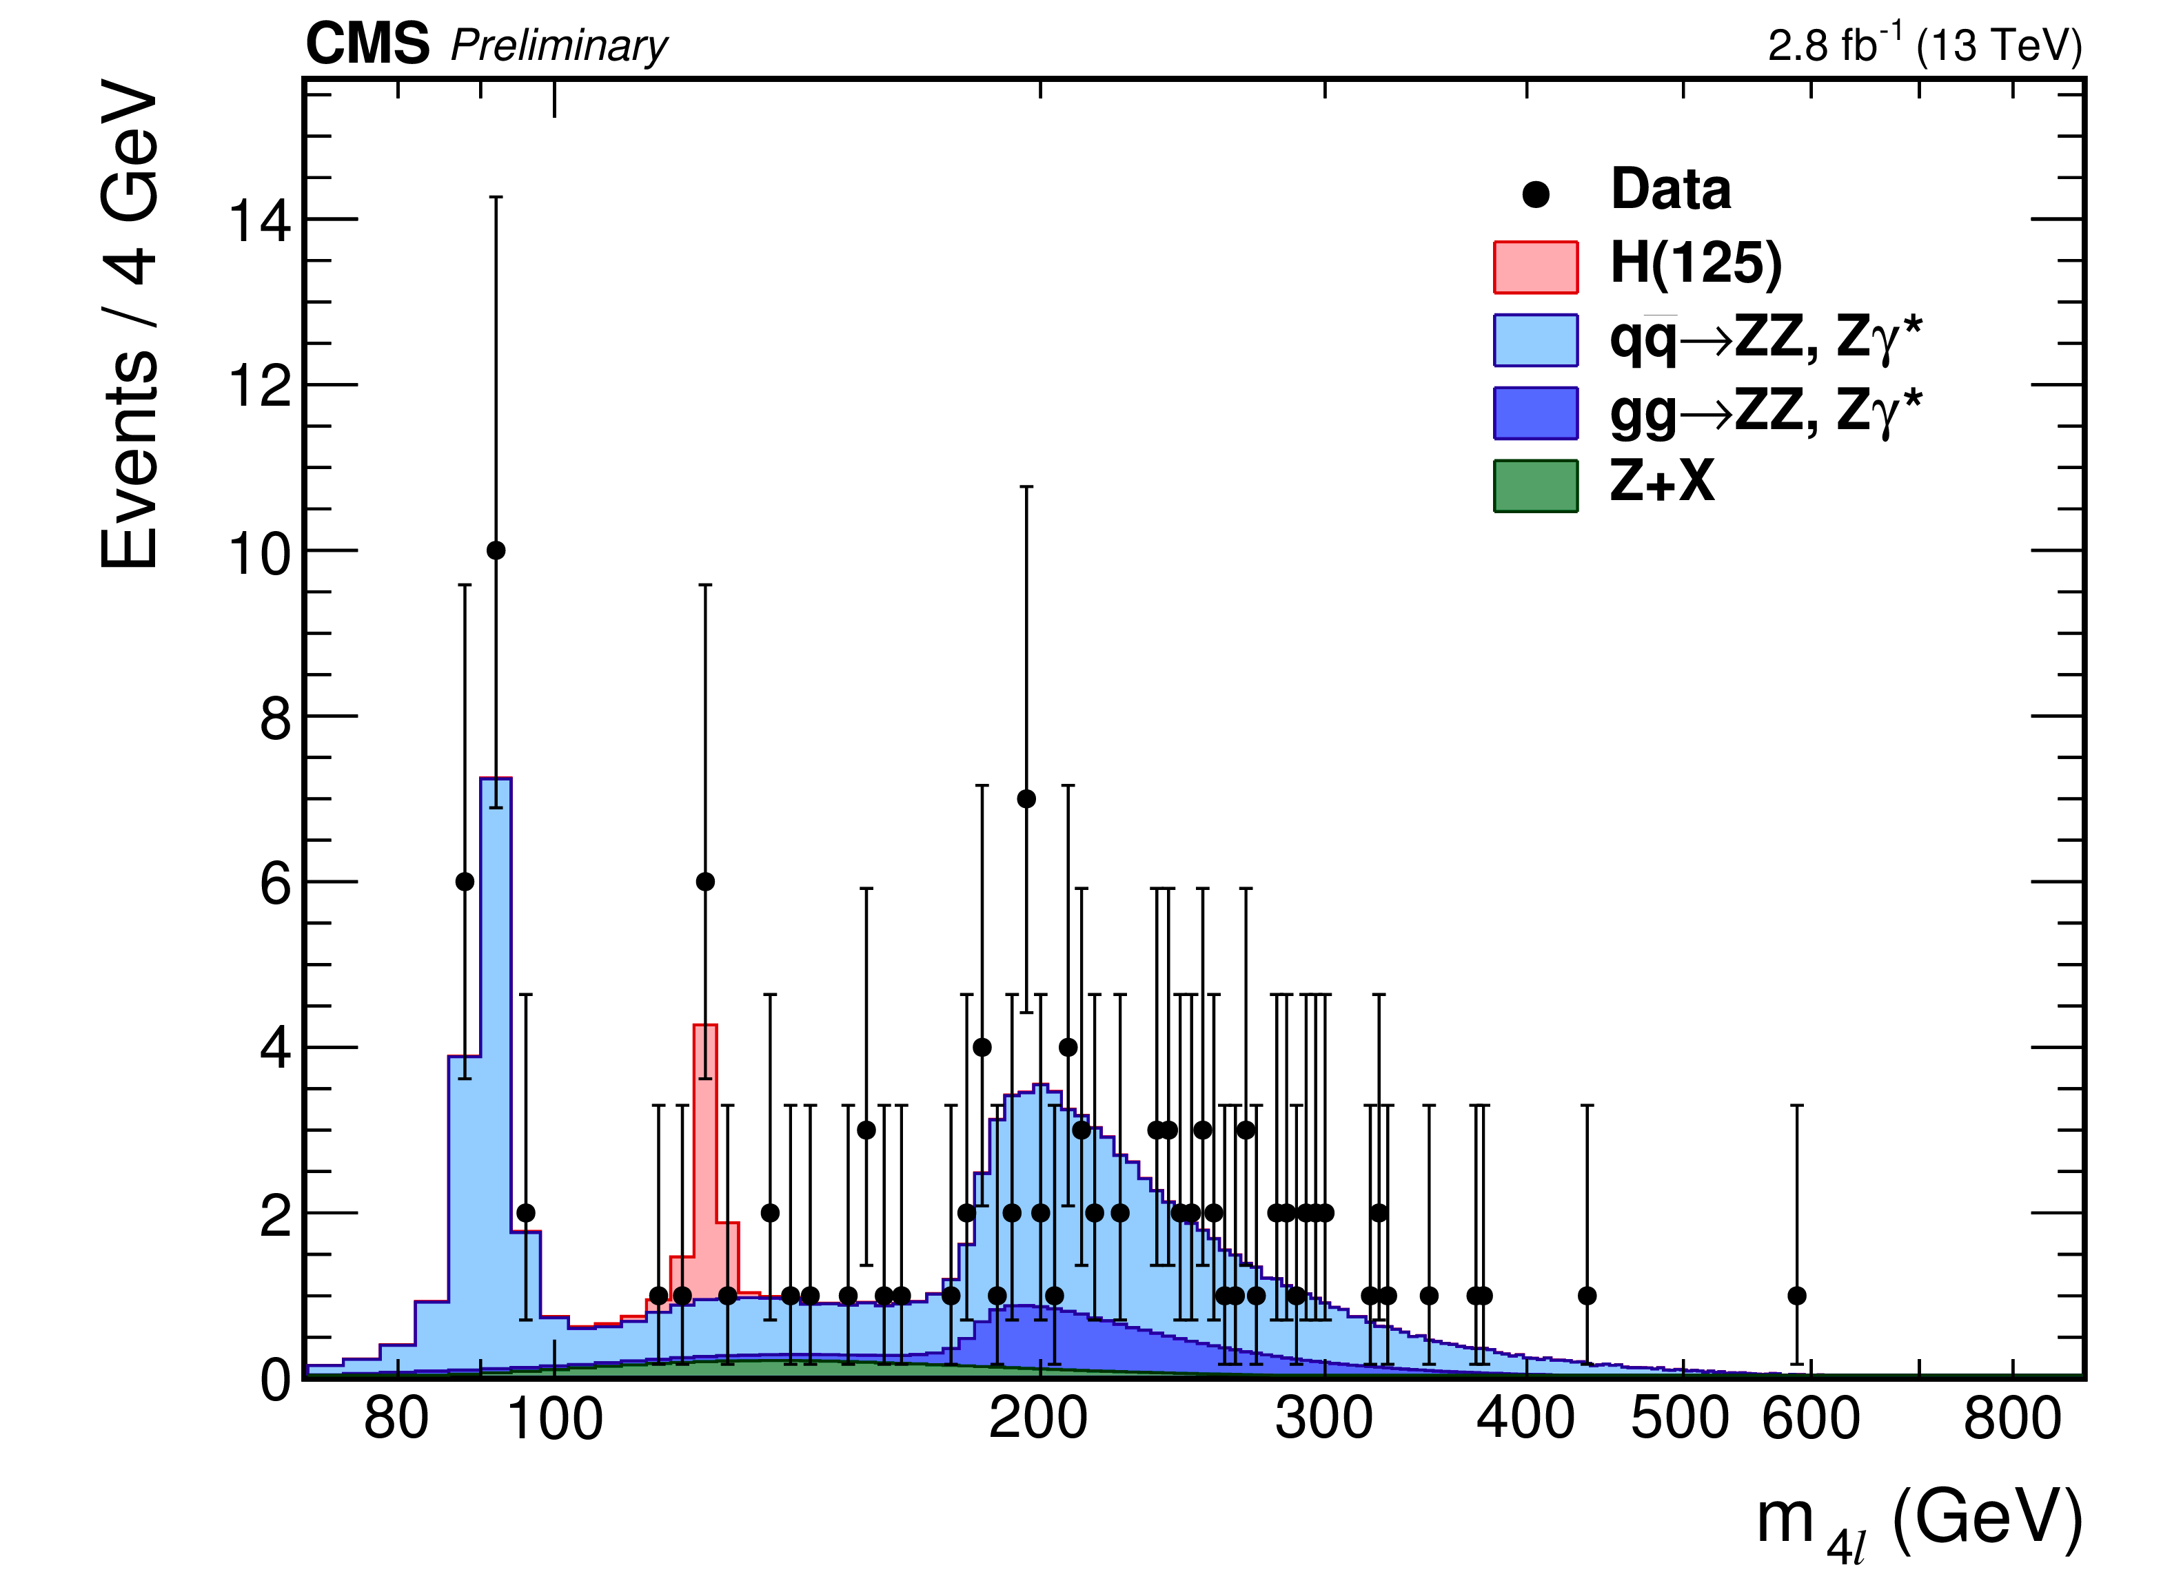
Other channels? ZZ→4l
CMS-PAS-HIG-15-004

